Slide 1
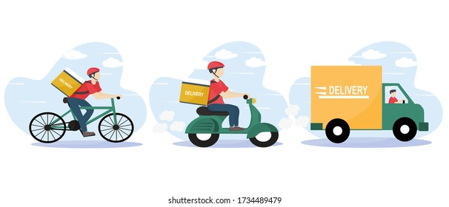


Improving Worker Learning in the Gig Economy
Shunan Jiang¹ and Park Sinchaisri²
Industrial Engineering and Operations Research Department¹ and Haas School of Business², University of California, Berkeley

Slide 2

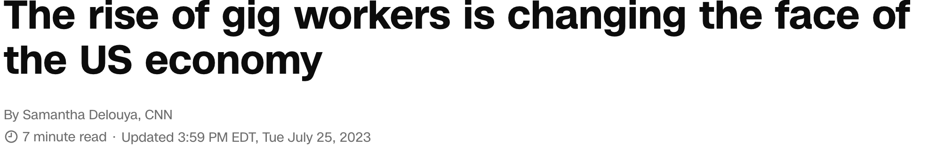
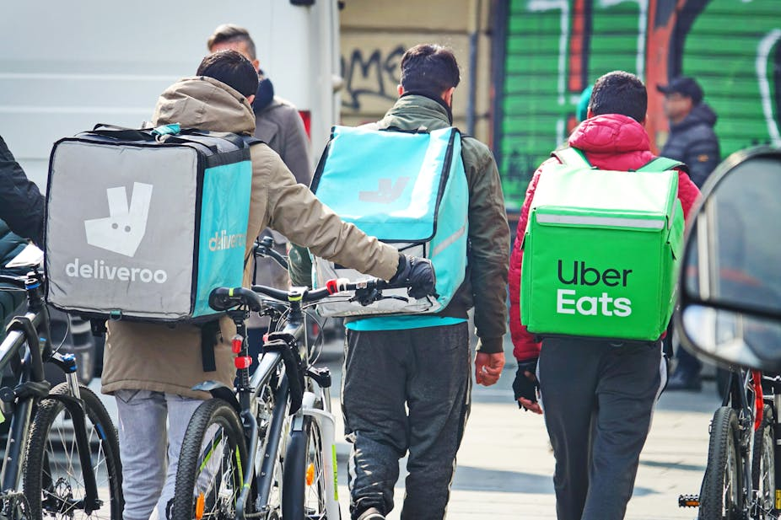
01
Introduction
Gig economy has been growing fast
attracting…
Consumers
Affordable
Convenient
Workers
Flexibility
Variety of work options
Our focus:
“36% of US workers engage in the gig economy”
- McKinsey & Company American Opportunity Survey
Notes:
Our research is motivated by what we observed in the gig economy. Gig economy is a labor market characterized by the prevalence of short-term contracts or freelance work, like uber and uber eats. It Grows more and more popular in recent years especially during the pandemic, now 36% of us workers engage in gig economy for primary wage or supplement for their current income. This number will continue to rise as millennials and Gen Z workers demonstrate an increased propensity for gig work as they look for a greater work-life balance. It provides affordable and convenient service to consumers, and at the same time it provides flexibility, a variety of jobs, for workers. On the surface, it seems having a lot of choices are good. however, we all know that humans are suboptimal especially facing a lot of choices. Let’s dive deeper and see what’s going on here
1. Introduce Gig economy in general, what it is, growing a lot especially during the pandemic; on the consumer side, … on the worker side, they have a lot of choices on the surface it’s good then dive into the difficulty 2. struglles, show figure 2 first, many options now, not only which platform to choose, even within the apps there’re tons of jobs to choose from, human have difficulty make good decisions it’s important , wellness- stay on the platform more, win-win, when human workers choose what jobs to work on, not only hard but also suboptimal
In today’s world, 36% of US workers engage in the gig economy for a primary wage or to supplement their current income. This number will continue to rise as millennials and Gen Z workers demonstrate an increased propensity for gig work as they look for a greater work-life balance.
At the same time, we observe that gig workers struggle to learn to maximize the value of their skills and talents. Figure one shows the concerns from workers on Reddit. Workers are discussing when and where to work, should they work closer to the airport or college towns during some certain times of the day? and also which type of job to work on – whether uber or uber eats? Figure 2 shows the screenshots from these two platforms. Also they’re wondering what job size/difficulty they should choose, should they always choose the shortest/simplest job or longer/more difficult job? We want to help workers learn how to make these decisions
They by working in certain roles at a certain time of day or day of the week to maximize earning potential. (Green 2020)
Learning is important in the gig economy as workers face a variety of decisions on a daily basis. They need to decide when to work, whether to accept or decline tasks, decide on the best route to the destination, and take into account other factors that directly impact their earnings, time management, and overall job satisfaction.

Slide 3
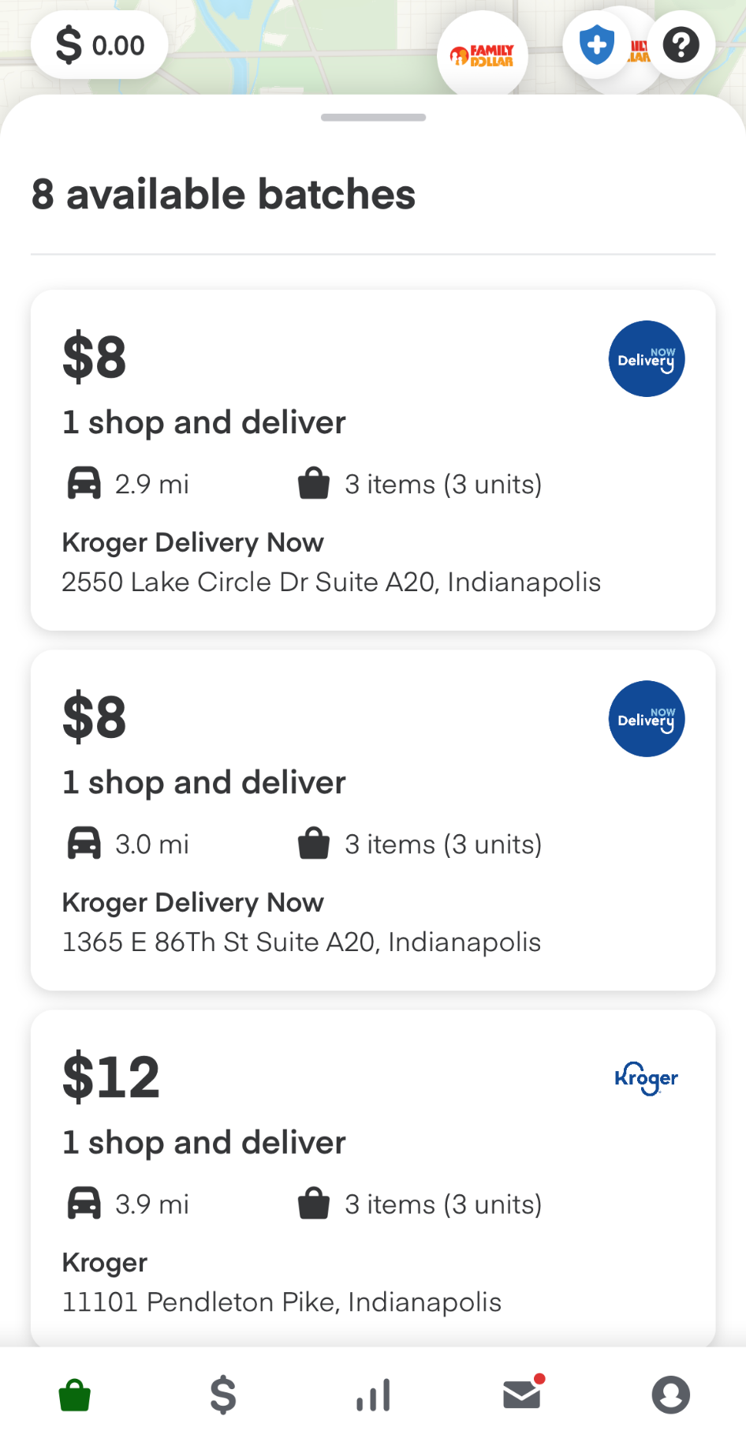
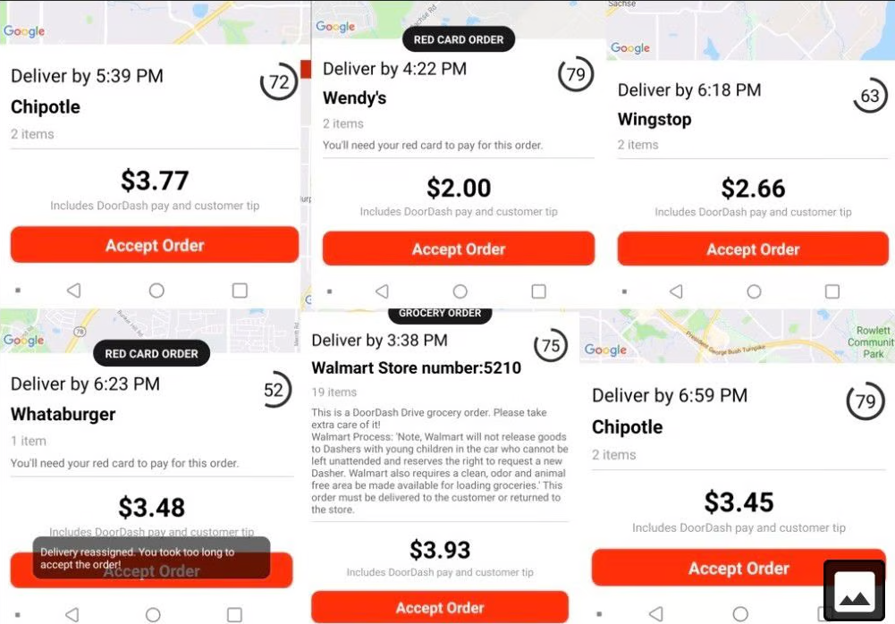



01
Introduction
Workers can choose among work options
Notes:
This is a screenshot showing what a worker on Doordash (it’s a popular US food delivery platform) could see everyday. You can see that workers need to choose their jobs from a lot of options, based on information like the payment, delivery time, restaurant etc. And not only do they need to browse options on one platform, they also need to decide which platform to work on. This is another screenshot showing the options workers are facing from another grocery delivery platform. On the surface it might sound like more options are always better, however psychology literature has suggested humans tend to make suboptimal decisions facing a lot of choices. Our job is to help workers make better decisions. The best way to understand how to work better at a job is becoming one - so Park and I actually signed up at an online grocery delivery platform and became their shoppers.
Explain even you are in other platforms where

Slide 4
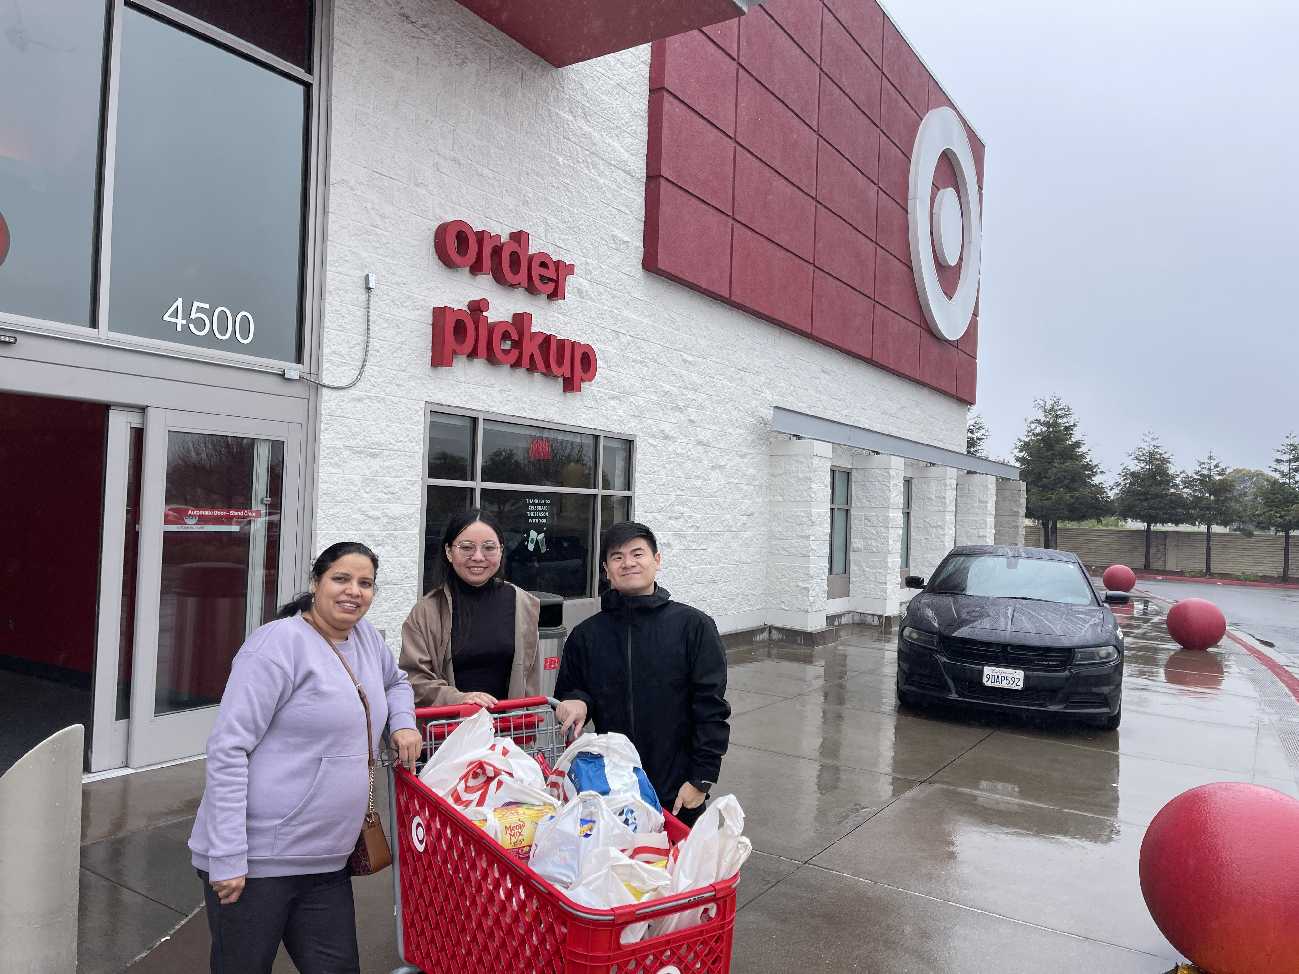
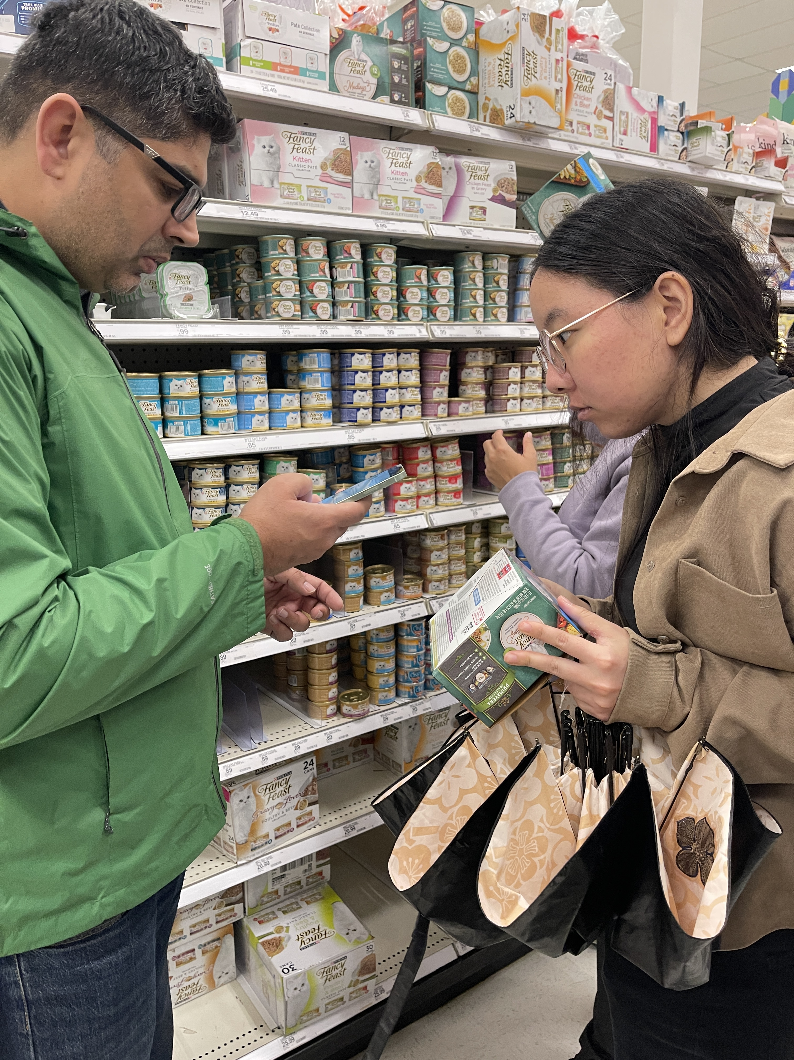
01
Introduction
New workers face a learning curve
Really struggling!
Notes:
It turned out it’s actually quite challenging, that's why we went back to do our research! First of all we have no idea which regions have the most orders, we signed up at Berkeley and waited two hours to get our first order. Maybe Berkeley are all poor students who couldn’t afford delivery at all. Second challenge is that, in our first order, most of the items are pet food. None of us have any experience with pets, so it takes us way more than expected time to figure out where the correct item is. Well it turned out we are not the worst -

Slide 5

01
Introduction
New workers may struggle…
How to find/choose jobs?
How to perform better on jobs?
In general, humans struggle to make optimal decisions. (Amar et al 2011, Ibanez et al 2017, KC et al., 2020)
Notes:
1. Introduce Gig economy in general, what it is, growing a lot especially during the pandemic; on the consumer side, … on the worker side, they have a lot of choices on the surface it’s good then dive into the difficulty 2. struglles, show figure 2 first, many options now, not only which platform to choose, even within the apps there’re tons of jobs to choose from, human have difficulty make good decisions it’s important , wellness- stay on the platform more, win-win, when human workers choose what jobs to work on, not only hard but also suboptimal
In today’s world, 36% of US workers engage in the gig economy for a primary wage or to supplement their current income. This number will continue to rise as millennials and Gen Z workers demonstrate an increased propensity for gig work as they look for a greater work-life balance.
At the same time, we observe that gig workers struggle to learn to maximize the value of their skills and talents. Figure one shows the concerns from workers on Reddit. Workers are discussing when and where to work, should they work closer to the airport or college towns during some certain times of the day? and also which type of job to work on – whether uber or uber eats? Figure 2 shows the screenshots from these two platforms. Also they’re wondering what job size/difficulty they should choose, should they always choose the shortest/simplest job or longer/more difficult job? We want to help workers learn how to make these decisions
They by working in certain roles at a certain time of day or day of the week to maximize earning potential. (Green 2020)
Learning is important in the gig economy as workers face a variety of decisions on a daily basis. They need to decide when to work, whether to accept or decline tasks, decide on the best route to the destination, and take into account other factors that directly impact their earnings, time management, and overall job satisfaction.

Slide 6
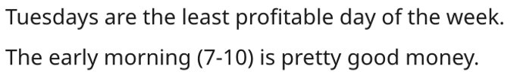
01
Introduction
Experienced workers learned some strategies
How to find/choose jobs?
How to perform better on jobs?
In general, humans struggle to make optimal decisions. (Amar et al 2011, Ibanez et al 2017, KC et al., 2020)
Humans learn from experience (Shafer et al 2001, Boh et al 2007, Argote 2012, Bavafa & Jónasson 2021)
Gig workers learn differently (Allon et al 2023, Guha & Corsten 2023, Dai et al 2024, Hernandez et al 2024)
Notes:
1. Introduce Gig economy in general, what it is, growing a lot especially during the pandemic; on the consumer side, … on the worker side, they have a lot of choices on the surface it’s good then dive into the difficulty 2. struglles, show figure 2 first, many options now, not only which platform to choose, even within the apps there’re tons of jobs to choose from, human have difficulty make good decisions it’s important , wellness- stay on the platform more, win-win, when human workers choose what jobs to work on, not only hard but also suboptimal
In today’s world, 36% of US workers engage in the gig economy for a primary wage or to supplement their current income. This number will continue to rise as millennials and Gen Z workers demonstrate an increased propensity for gig work as they look for a greater work-life balance.
At the same time, we observe that gig workers struggle to learn to maximize the value of their skills and talents. Figure one shows the concerns from workers on Reddit. Workers are discussing when and where to work, should they work closer to the airport or college towns during some certain times of the day? and also which type of job to work on – whether uber or uber eats? Figure 2 shows the screenshots from these two platforms. Also they’re wondering what job size/difficulty they should choose, should they always choose the shortest/simplest job or longer/more difficult job? We want to help workers learn how to make these decisions
They by working in certain roles at a certain time of day or day of the week to maximize earning potential. (Green 2020)
Learning is important in the gig economy as workers face a variety of decisions on a daily basis. They need to decide when to work, whether to accept or decline tasks, decide on the best route to the destination, and take into account other factors that directly impact their earnings, time management, and overall job satisfaction.

Slide 7
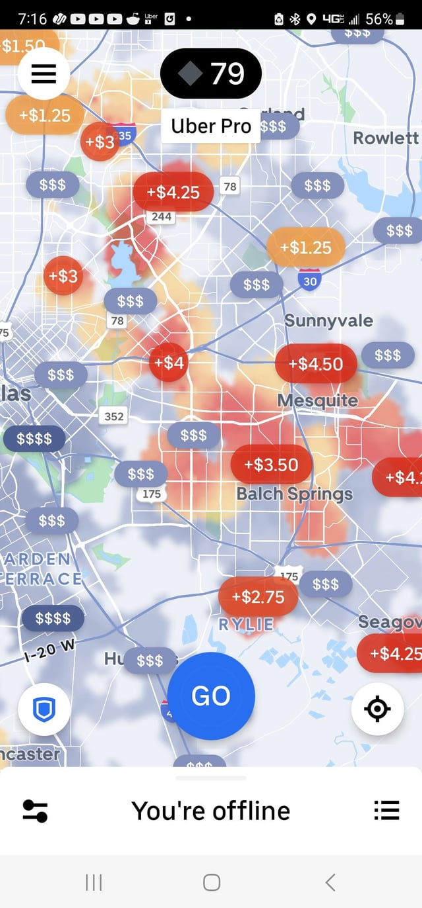
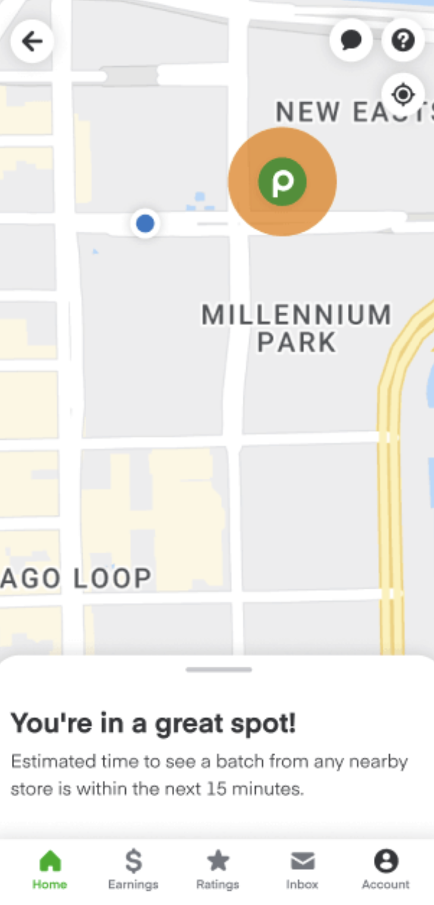
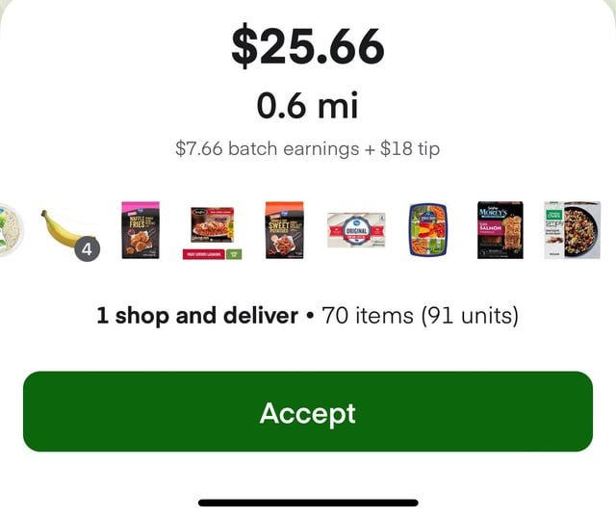
01
Introduction
Platforms provide recommendations
Some benefit from them…
(Knight et al 2022, Zhang et al 2022, Do et al 2024)
…but others resist
(Dietvorst el al 2015, Dietvorst et al 2018, Castelo et al 2019, Sun et al 2022, Das Swain et al 2024, Balakrishnan et al 2025, Bastani et al 2025)
Notes:
1. Introduce Gig economy in general, what it is, growing a lot especially during the pandemic; on the consumer side, … on the worker side, they have a lot of choices on the surface it’s good then dive into the difficulty 2. struglles, show figure 2 first, many options now, not only which platform to choose, even within the apps there’re tons of jobs to choose from, human have difficulty make good decisions it’s important , wellness- stay on the platform more, win-win, when human workers choose what jobs to work on, not only hard but also suboptimal
In today’s world, 36% of US workers engage in the gig economy for a primary wage or to supplement their current income. This number will continue to rise as millennials and Gen Z workers demonstrate an increased propensity for gig work as they look for a greater work-life balance.
At the same time, we observe that gig workers struggle to learn to maximize the value of their skills and talents. Figure one shows the concerns from workers on Reddit. Workers are discussing when and where to work, should they work closer to the airport or college towns during some certain times of the day? and also which type of job to work on – whether uber or uber eats? Figure 2 shows the screenshots from these two platforms. Also they’re wondering what job size/difficulty they should choose, should they always choose the shortest/simplest job or longer/more difficult job? We want to help workers learn how to make these decisions
They by working in certain roles at a certain time of day or day of the week to maximize earning potential. (Green 2020)
Learning is important in the gig economy as workers face a variety of decisions on a daily basis. They need to decide when to work, whether to accept or decline tasks, decide on the best route to the destination, and take into account other factors that directly impact their earnings, time management, and overall job satisfaction.

Slide 8
01
Introduction
Research Questions
How do gig workers learn to improve performance short-term vs. long-term?
How do gig workers make decisions on the jobs?
How to help workers improve learning/decision making?
Today: Empirical analyses on learning to improve task performance + learning to choose better/bundle orders

Slide 9
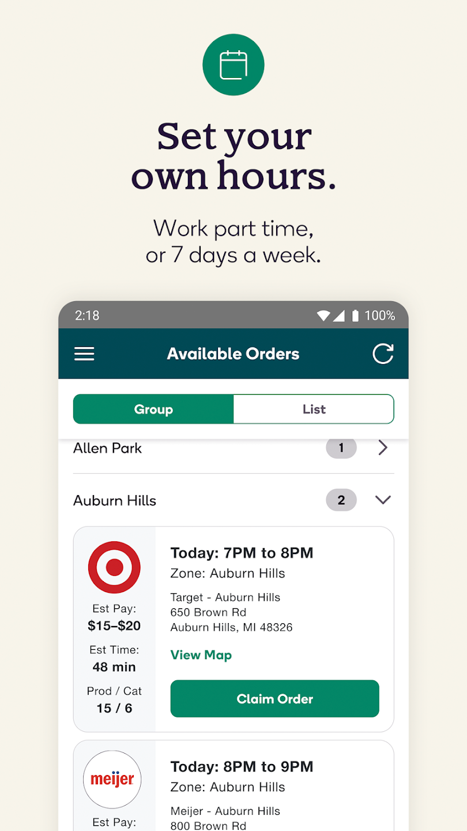



02
Empirical Analysis
Industry Partner
A U.S. online delivery platform
Notes:
OK, let’s first go over our industry partner. We are lucky to collaborate with a US online grocery delivery platform. On this platform customers place orders online, and then shoppers get to browse orders like this (they can see the estimated pay, time, items in the order, address of the store and distance from the customer). Then the worker will choose orders and go to local stores to pick up the items, and finally they will deliver the items to customers.
Doesn’t have a large inventory of products for customers to purchase.
Instead, a shopper will go to a local store, purchase the items, and then deliver them directly to the customer’s door.
Shoppers have to be 18 or older; smart phone, car, driver’s license, insurance, and the ability to lift 45 lbs.

Slide 10
02
Empirical Analysis
Industry Partner
A U.S. online delivery platform
Doesn’t have a large inventory of products for customers to purchase.
Instead, a shopper will go to a local store, purchase the items, and then deliver them directly to the customer’s door.
Shoppers have to be 18 or older; smart phone, car, driver’s license, insurance, and the ability to lift 45 lbs.
Notes:
Doesn’t have a large inventory of products for customers to purchase.
Instead, a shopper will go to a local store, purchase the items, and then deliver them directly to the customer’s door.
Shoppers have to be 18 or older; smart phone, car, driver’s license, insurance, and the ability to lift 45 lbs.

Slide 11
02
Empirical Analysis
Industry Partner: Data
1-year records of orders in NYC are from November 2022 to October 2023
1,269,815 orders across 788 stores
5,292 shoppers (1,131 “new”)
Orders: Store ID, # items, most common categories, distance to customers
Workers: Signup hours, orders suggested to them daily, tenure with platform
Performance: On-time delivery, customer ratings, amount of tips

Slide 12
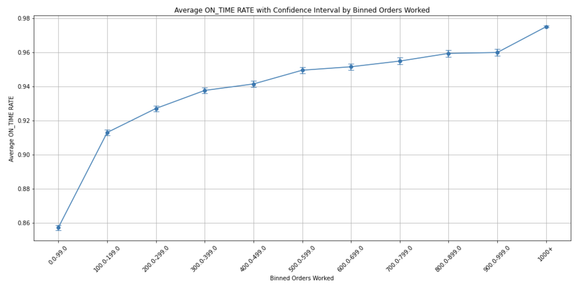
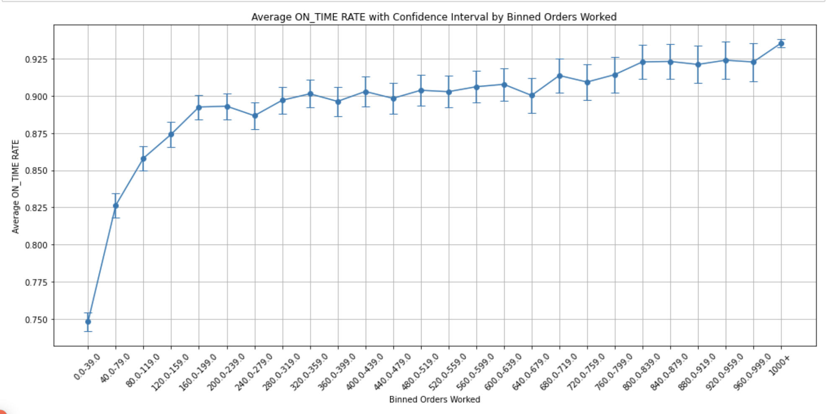
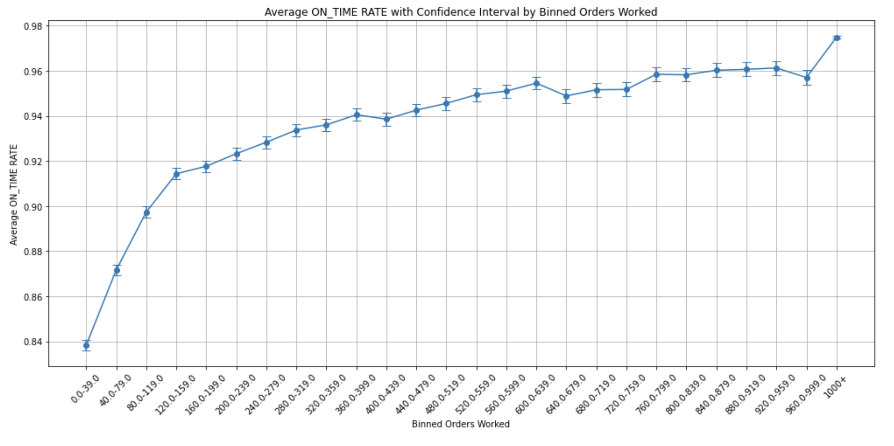
02
Empirical Analysis
Preliminary: Service Quality
Controlling for new workers starting in November 2022
Average on-time delivery rate
Impact on on-time | Coefficient
# Orders done from the same store | 6.0552e-05*** (0.0025236)
# Orders done from the same store ^2 | -8.9995e-09*** (1.6775e-09)
# Orders done from other stores | 5.9109e-05*** (0.0001787)
# Orders done from other stores ^2 | -8.8744e-09*** (0.0149002)
Control Variables | Yes
Individual FE | Yes
Time FE | Yes
We’ll use the first 100 and 200 orders as workers’ key milestones of learning
= 1,000 orders, 6.0% ↑
Notes:
controlling for new workers, we did a two-way fixed effects regression on worker’s service quality (here we use on time rate, the percentage of orders delivered on time) vs. the number of orders they have worked in the store, and we found workers indeed learn through experiences. One thing to note is that their learning is nonlinear, most of their learning happened in the first 100 and 200 orders (later on when we analyze worker decisions we will mostly focus on their first 200 orders). And our results show on average after 1000 orders that’s like 6% improvement of on time performances.
This is an average performance of workers - however workers might be different.

Slide 13
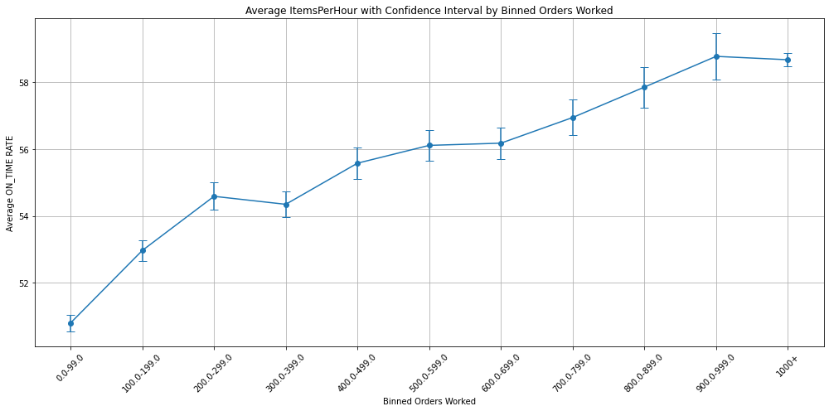
02
Empirical Analysis
Preliminary: Productivity Learning
Controlling for new workers starting in November 2022
Average # items picked / hour
Impact on # items | Coefficient
# Orders done from the same store | 9.4281e-03** (0.007595)
# Orders done from the same store ^2 | --5.4681e-06** (0.003098)
# Orders done from other stores | 6.3414e-03* ( 0.022478)
# Orders done from other stores ^2 | -7.6253e-07 (0.235005)
Control Variables | Yes
Individual FE | Yes
Time FE | Yes
= 1000 orders, 9.4 ↑

Slide 14
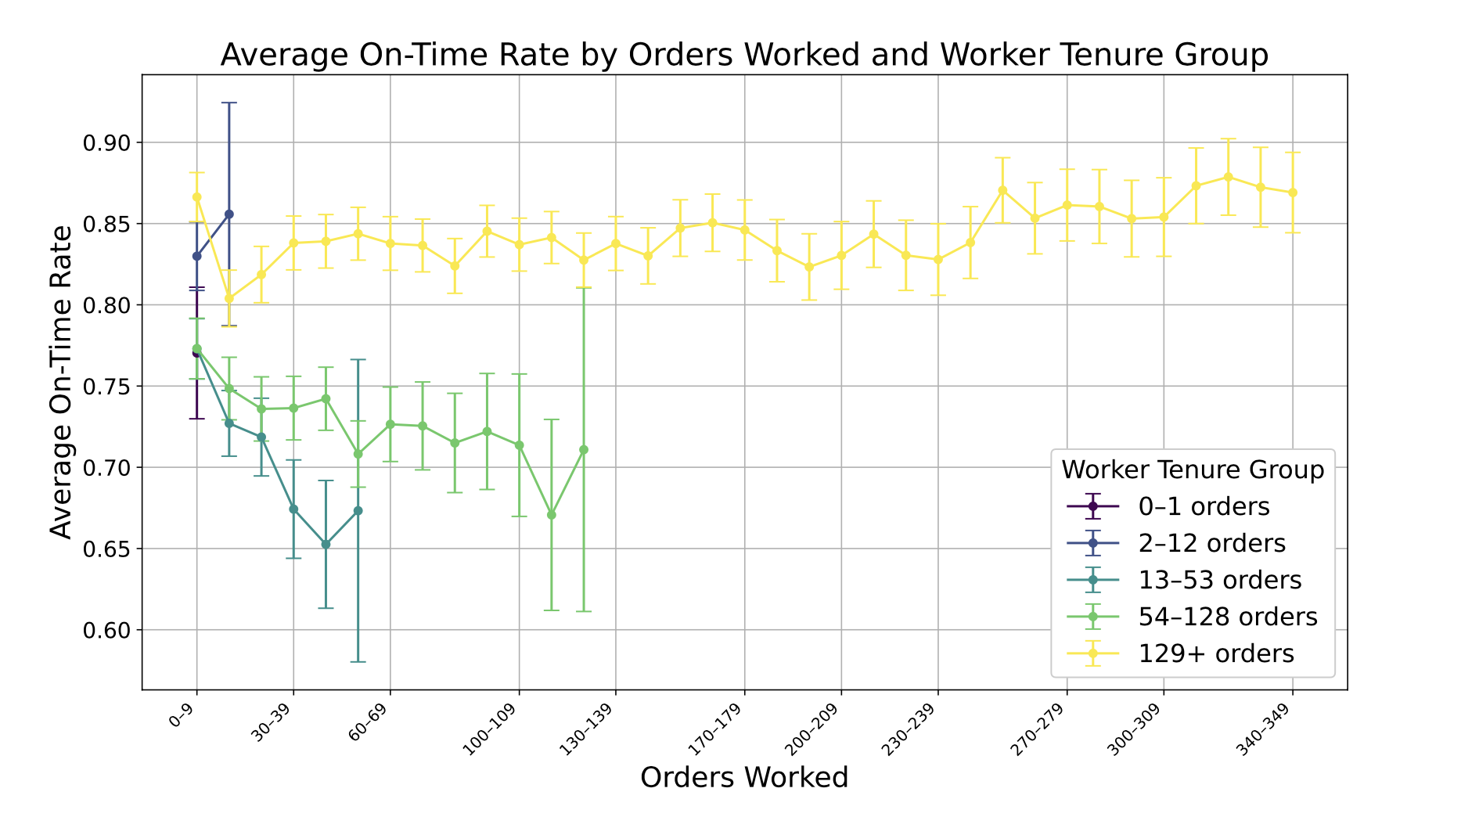
02
Empirical Analysis
Preliminary: Workers Are Different
Workers who stay the longest are also workers who perform the best
Group by total orders (quantiles)
in the year
Notes:
We further group workers to five groups based on how many orders they have completed in total, I will show you a figure showing how these different groups perform quite differently - this is a figure showing different groups’ performances over time, we found that the workers who stay the longest, work the most number of orders on the platform are also workers who perform the best - even from the beginning. And workers who didn’t perform well in the beginning and failed to learn later, tend to quit the platform. Why are these workers different? Do they make different decisions on choosing the jobs? In order to answer these questions, we use a mnl model to try to recover different workers’ preferences of jobs over time.

Slide 15
02
Empirical Analysis
Clustering Workers by Performance
Productivity metric: # items per hour
Start = First 100 orders; End = Second 100 orders
Start\End | Low | Medium | High
Low | 74.074074 | 22.222222 | 3.703704
Medium | 22.222222 | 51.851852 | 25.925926
High | 3.703704 | 25.925926 | 70.370370
Notes:
Mean and cut off

Slide 16
02
Empirical Analysis
Clustering Workers by Performance
Productivity metric: # items per hour
Start = First 100 orders; End = Second 100 orders
Start\End | Low | Medium | High
Low | 74.074074 | 22.222222 | 3.703704
Medium | 22.222222 | 51.851852 | 25.925926
High | 3.703704 | 25.925926 | 70.370370
Most workers stayed in the same cluster
Notes:
Mean and cut off

Slide 17
02
Empirical Analysis
Clustering Workers by Performance
Productivity metric: # items per hour
Start = First 100 orders; End = Second 100 orders
Start\End | Low | Medium | High
Low | 74.074074 | 22.222222 | 3.703704
Medium | 22.222222 | 51.851852 | 25.925926
High | 3.703704 | 25.925926 | 70.370370
Most workers stayed in the same cluster, but some improved
How do their choices influence their learning?
Notes:
Mean and cut off

Slide 18


02
Empirical Analysis
How Workers Choose Orders
Sign up for working hours and regions:
Platform will send them special orders based on their signups
Doesn’t sign up or ignore the special orders: Browse a list of all available orders

Slide 19
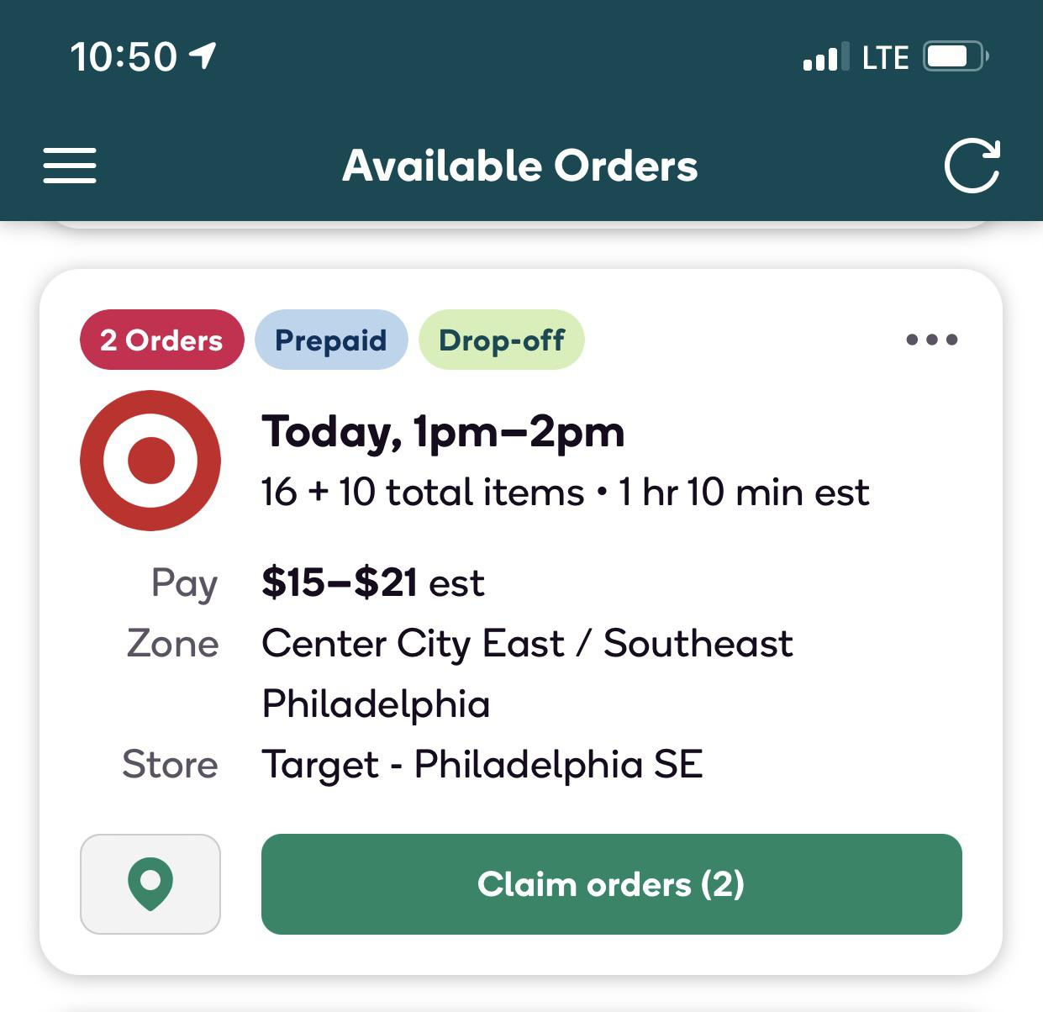
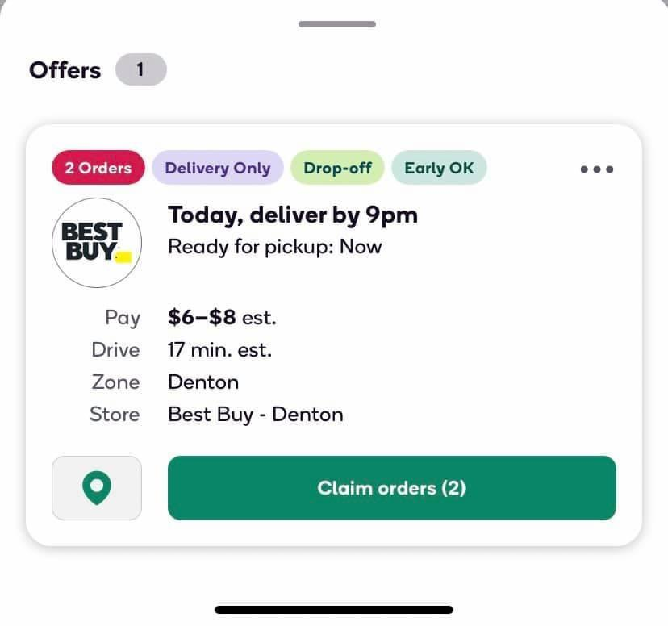
02
Empirical Analysis
Sometimes Orders Are Bundled
Platform-Bundled: Always from the same store with delivery windows within 1 hour difference
65% orders completed are bundled by the platform

Slide 20
02
Empirical Analysis
Learning: Self-Bundling
We’re investigating Self-Bundling = where workers combine orders by themselves without the platform’s recommendation
Identified by the overlapping of the shopping start times and delivery times
This could mean…
Bundling within the same store and category
Bundling within the same store across categories
66.81% of bundled orders have different common categories
Bundling across stores
 | Bundled | Not Bundled
Pay/order | 14.785829 | 18.302520
# Items/order | 11.898361 | 13.666024

Slide 21
02
Empirical Analysis
Learning to Bundle Right
What bundle behaviors make people improve?
# average concurrent orders
Start\End | Low | Medium | High
Low-First 100 | 2.223500 | 1.925000 | 2.240000
Low-Second 100 | 2.632000 | 2.333333 | 2.190000
High-First 100 | 2.450000 | 2.745714 | 2.435263
High-Second 100 | 3.500000 | 3.315714 | 2.725789
Initial low performers, who tried more bundling early on and adjusted down later, ended up improving performance
Notes:
T test on pairwise, row and column

Slide 22
02
Empirical Analysis
Learning to Bundle Right
What bundle behaviors make people improve?
# average concurrent orders
Start\End | Low | Medium | High
Low-First 100 | 2.223500 | 1.925000 | 2.240000
Low-Second 100 | 2.632000 | 2.333333 | 2.190000
High-First 100 | 2.450000 | 2.745714 | 2.435263
High-Second 100 | 3.500000 | 3.315714 | 2.725789
Initial low performers, who tried more bundling early on and adjusted down later, ended up improving performance
Those performing poorly later on tend to be those who over-bundled.
Notes:
T test on pairwise, row and column

Slide 23
02
Empirical Analysis
Learning to Bundle Right
What bundle behaviors make people improve?
P(bundling without recommendation)
Start\End | Low | Medium | High
Low-First 100 | 0.171333 | 0.174615 | 0.105000
Low-Second 100 | 0.228667 | 0.226923 | 0.135000
Low-First 100 | 1.141000 | 1.120769 | 1.105000
Low-Second 100 | 1.166000 | 1.093846 | 1.090000
Low-First 100 | 1.729000 | 1.819231 | 1.745000
Low-Second 100 | 1.852333 | 2.022308 | 1.950000
Those doing well did less self-bundling / more platform-bundling.
Bundles with different stores
…did less across-store bundling
Bundles with different top categories
…and did less bundling across different categories
Those performing poorly later on tend to be those who over-bundled.
Notes:
T test on pairwise, row and column

Slide 24
02
Empirical Analysis
Learning to Bundle Right
What might be the underlying mechanisms?
Initial low performers, who tried more bundling early on and adjusted down later, ended up improving performance
Those doing well did less self-bundling / more platform-bundling.
…did less across-store bundling
Those performing poorly later on tend to be those who over-bundled.
…and did less bundling across different categories
Those performing poorly later on tend to be those who over-bundled.
Notes:
T test on pairwise, row and column

Slide 25

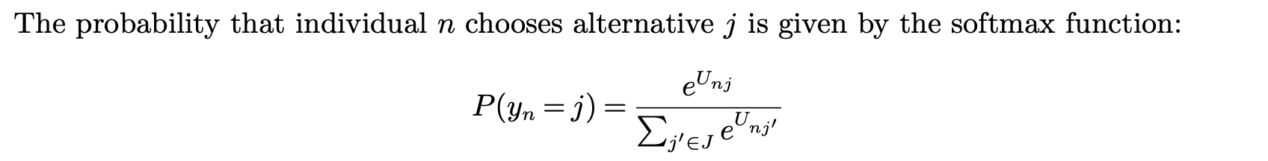
02
Empirical Analysis
Learning to Choose Better Orders, Given Recommendations
Estimate an MNL choice model using MLE
Features for estimating utility:
Past Frequency: The proportion of all previous orders completed by the worker that were fulfilled at the same store; Higher = more exploitation of familiar stores
Recommended: Binary variable, 1 if order is recommended by platform; 0 else
Dummy group indicators: most productive (129+ orders) as reference group
All the other order information workers can see while browsing
Notes:
Flash the math
Thanks to the richness of our dataset, we are able to recover the full choice sets of all workers and estimate the parameters of our MNL model using MLE.
The features we use in our MNL choice model includes: this variable reinforcement, which represents how much money the worker has made in the store. This idea is borrowed from human reinforcement learning literature, where we assume people tend to choose actions where they have earned more rewards before. You can imagine a higher value of this coefficient means that workers are more likely to visit places they have earned more money with, therefore means they are more exploitive. We also include a dummy categorical variable to indicate which group shoppers belong to, and we control for all the other information workers can see. In the next slide, I will show you the results of our MNL model.

Slide 26
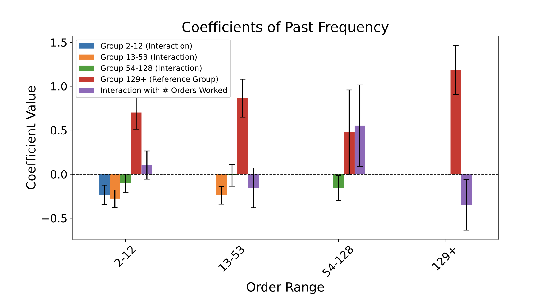
02
Empirical Analysis
Learning to Choose Better Orders, Given Recommendations
Those doing well overall are more exploiting familiar stores initially
Over time people become more explorative
Positive = Exploiting familiar stores
Negative = Exploring new stores
Starting from beginning, as the worker completed more orders
Notes:
This is a figure showing the coefficient of the variable reinforcement of different groups of workers over time. The purple bars represent our reference group - the best shoppers who have worked more than 300 orders in a year and who perform the best as well. The x axis here represents time, for example the first index here represents the first 10 orders of workers. Here the positive purple means more likely to choose stores where they earned more money in the past; we can see that almost all the other groups have a relatively higher coefficient than the reference group, which means all the other groups are more exploitive than the best shoppers. And we can also observe that overtime, people tend to become more exploitive.
Now we know that worker indeed learn through experiences and exploration, how can we incorporate these insights into decision making?

Slide 27
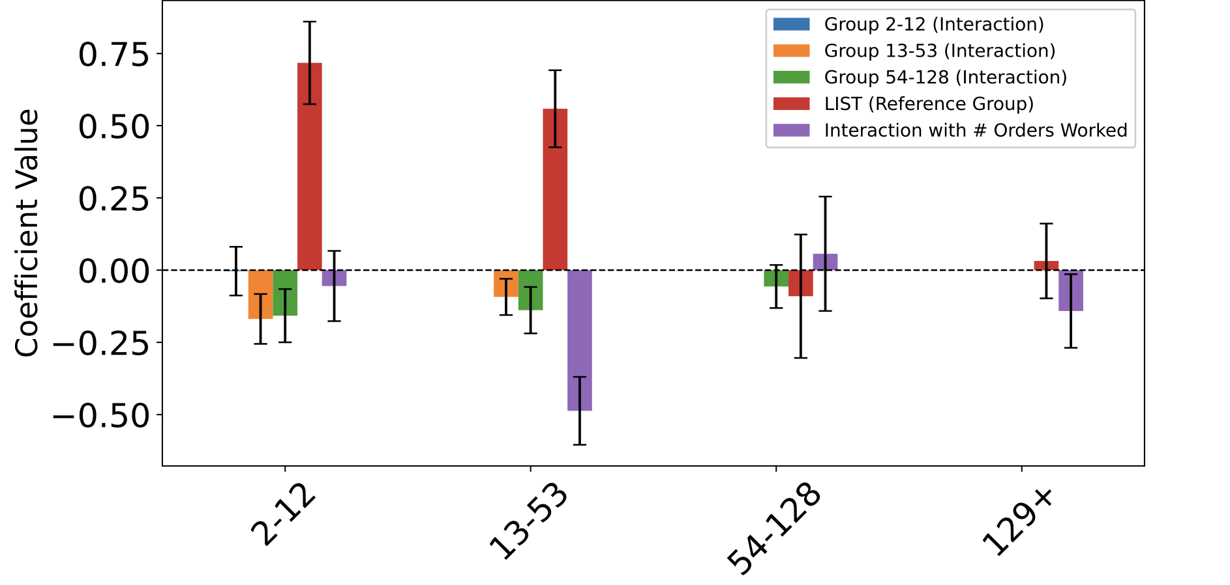
02
Empirical Analysis
Learning to Choose Better Orders, Given Recommendations
Those doing well and staying for long reply more on platform recommendations in the beginning
Over time workers become more independent of platform recommendations
Coefficient of Recommended
Positive = Choosing recommended orders
We also find that those doing well started off more exploitative, only exploring new stores later on.
Negative = Choosing their own orders
Starting from beginning, as the worker completed more orders
Notes:
This is a figure showing the coefficient of the variable reinforcement of different groups of workers over time. The purple bars represent our reference group - the best shoppers who have worked more than 300 orders in a year and who perform the best as well. The x axis here represents time, for example the first index here represents the first 10 orders of workers. Here the positive purple means more likely to choose stores where they earned more money in the past; we can see that almost all the other groups have a relatively higher coefficient than the reference group, which means all the other groups are more exploitive than the best shoppers. And we can also observe that overtime, people tend to become more exploitive.
Now we know that worker indeed learn through experiences and exploration, how can we incorporate these insights into decision making?

Slide 28

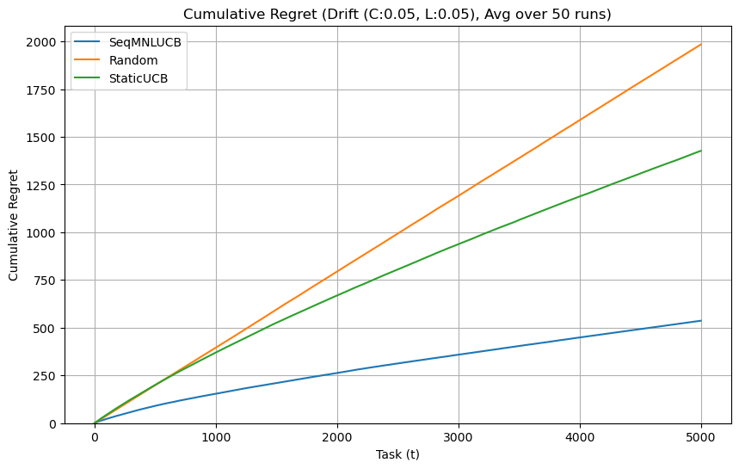
03
What’s Next?
Designing a Recommendation System + Experiments
Learning-Aware Recommendation System
Dynamically recommend jobs to maximize cumulative, long-term service quality
Balancing (i) helping workers improve their performance and (ii) aligning workers with platform’s objectives
Key features:
Willingness to accept as time-varying MNL bandit
Learning curve with linear drift
Simulation shows it achieves sublinear regret in a drifting environment (compared to random / static UCB)
Notes:
"Building upon our empirical findings, we designed an algorithmic solution that actively supports gig worker learning. This solution moves beyond traditional engagement metrics like click-through rates, which often focus narrowly on short-term interactions."
"Instead, our recommendation system directly optimizes for long-term service quality, specifically targeting metrics such as on-time delivery and customer satisfaction."
"By dynamically assigning tasks, the algorithm not only helps gig workers continuously improve their skills but also strategically aligns worker activities with critical business objectives."
"Why is this important to businesses? Because aligning recommendations with strategic goals like worker retention and platform reputation directly translates into reduced turnover, lower training costs, and ultimately a stronger competitive edge in the gig economy.”
Given this objective in mind, let's now discuss how we plan to further refine our algorithm.”
We model each worker’s willingness to accept as a multinomial logit that changes over time.
Preferences aren’t fixed, they drift smoothly, with sub-Gaussian fluctuations (as suggested by our empirical studies
We capture total variation in a drift budget
This model and budget let us track changing worker tastes and guide our explore–exploit strategy.
Each worker has an underlying skill level that shifts gradually over time. On every task, their “true” proficiency increases or decreases by a fixed personal rate (their learning slope) plus a small random fluctuation. If the slope is positive, they steadily improve; if it’s zero, they stay about the same; if it’s negative, they fatigue or decline. When a worker actually completes an accepted task, we don’t see their true proficiency exactly. Instead, we observe a noisy version of it, think of it as the true skill level plus some measurement error. Over the whole sequence of tasks, we track how much each worker’s expected skill can change. We sum up the largest expected jumps in proficiency between consecutive time steps across all workers. This total “drift budget” captures the overall non-stationarity of workers’ learning curves. The algorithm’s performance guarantee (its regret bound) will finally depend on two things: the total amount of choice-drift (how much acceptance probabilities can shift) and this learning-drift budget (how much skill levels can shift).

Slide 29
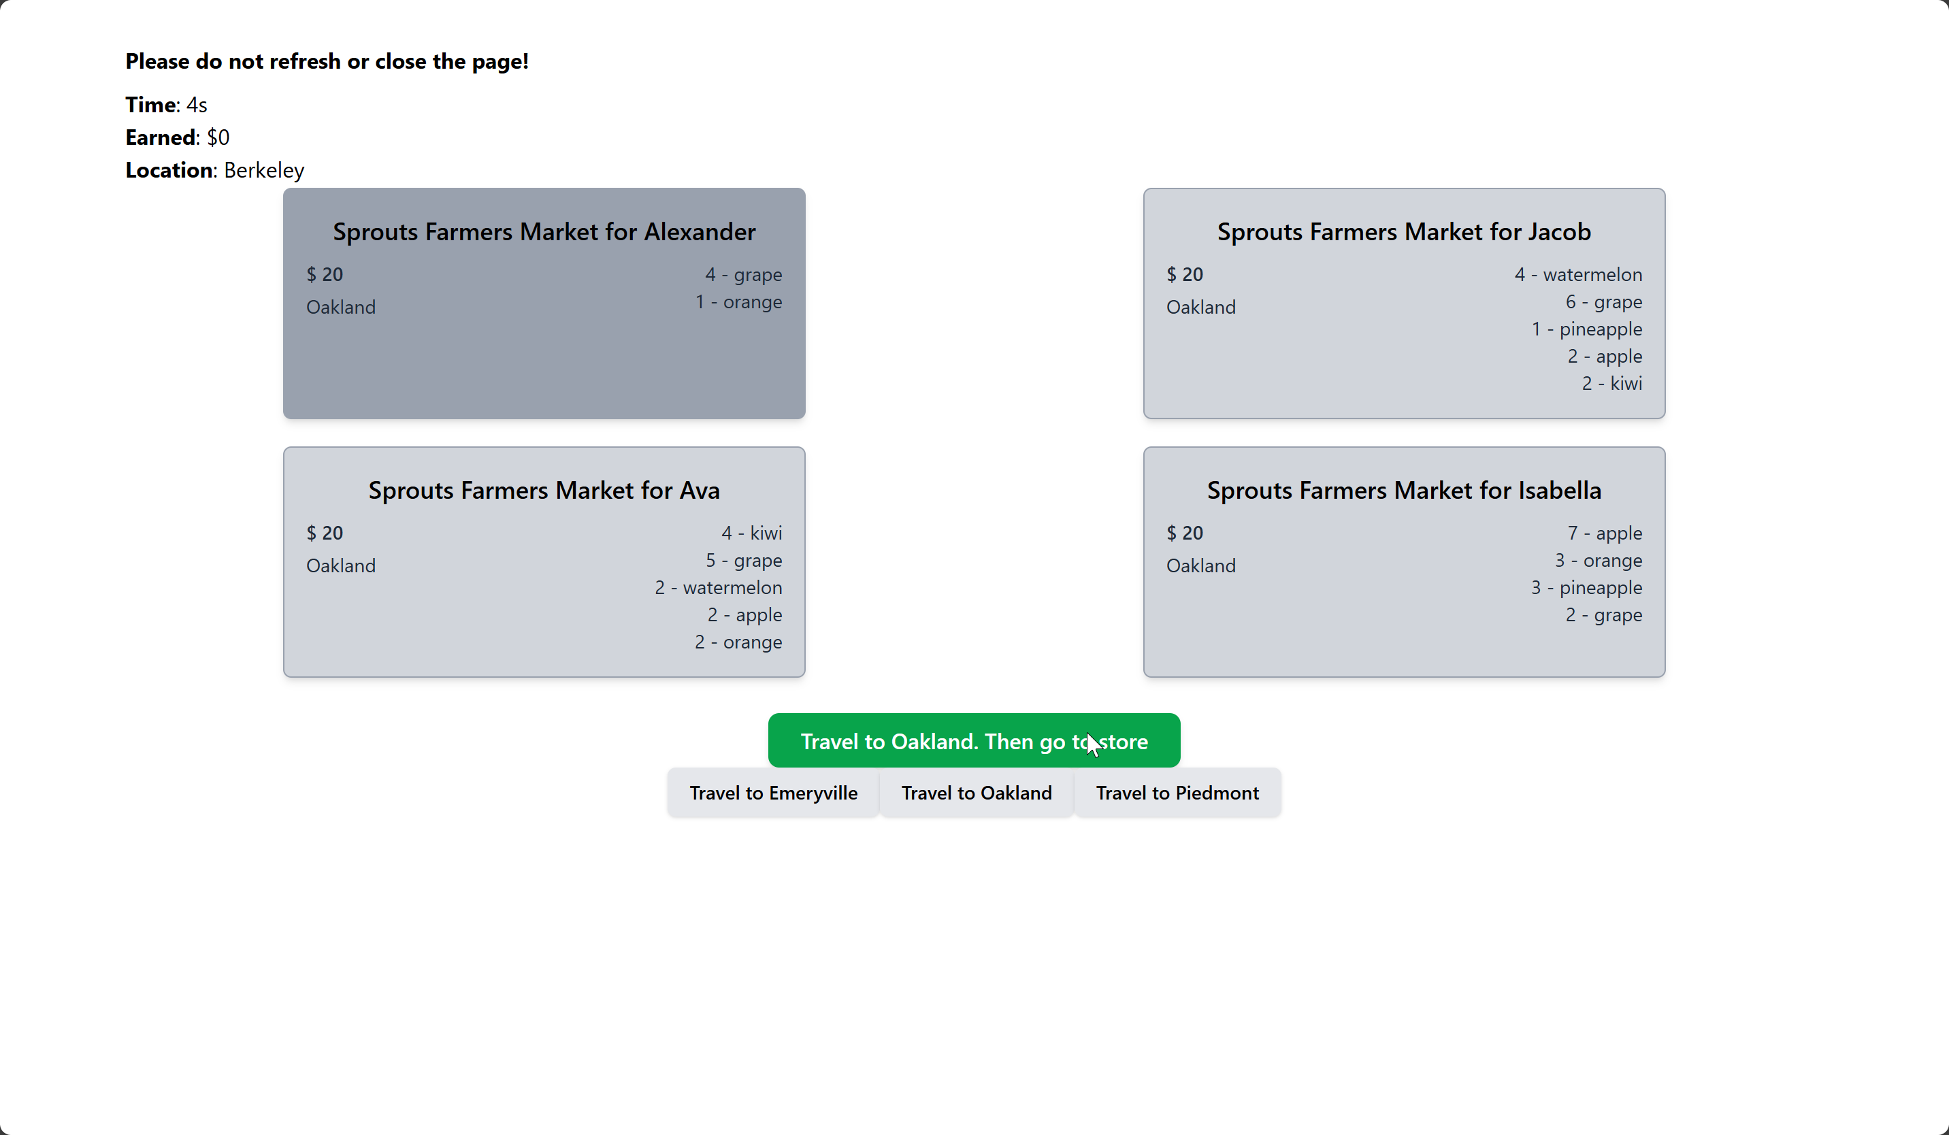
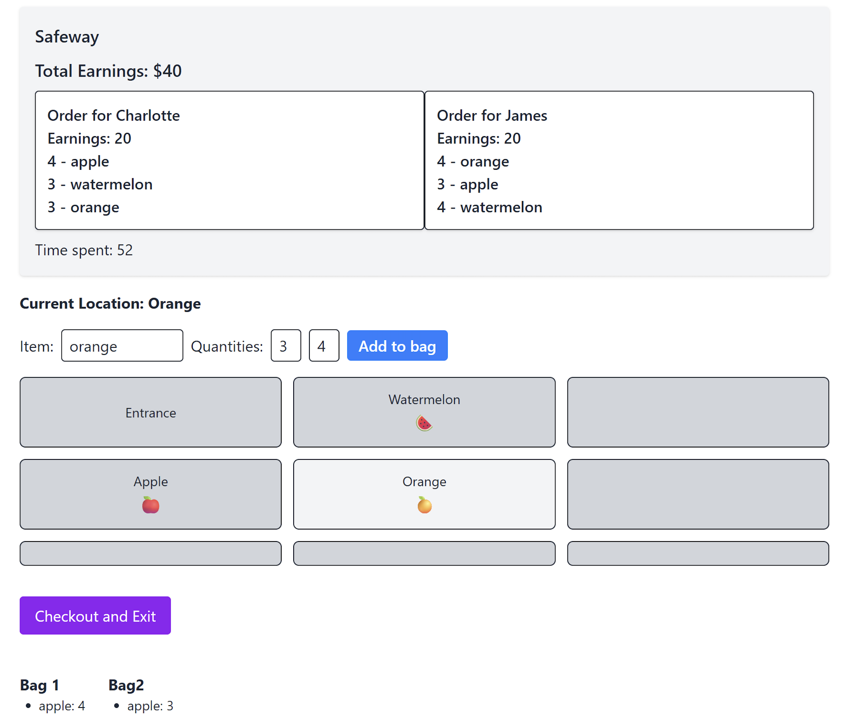
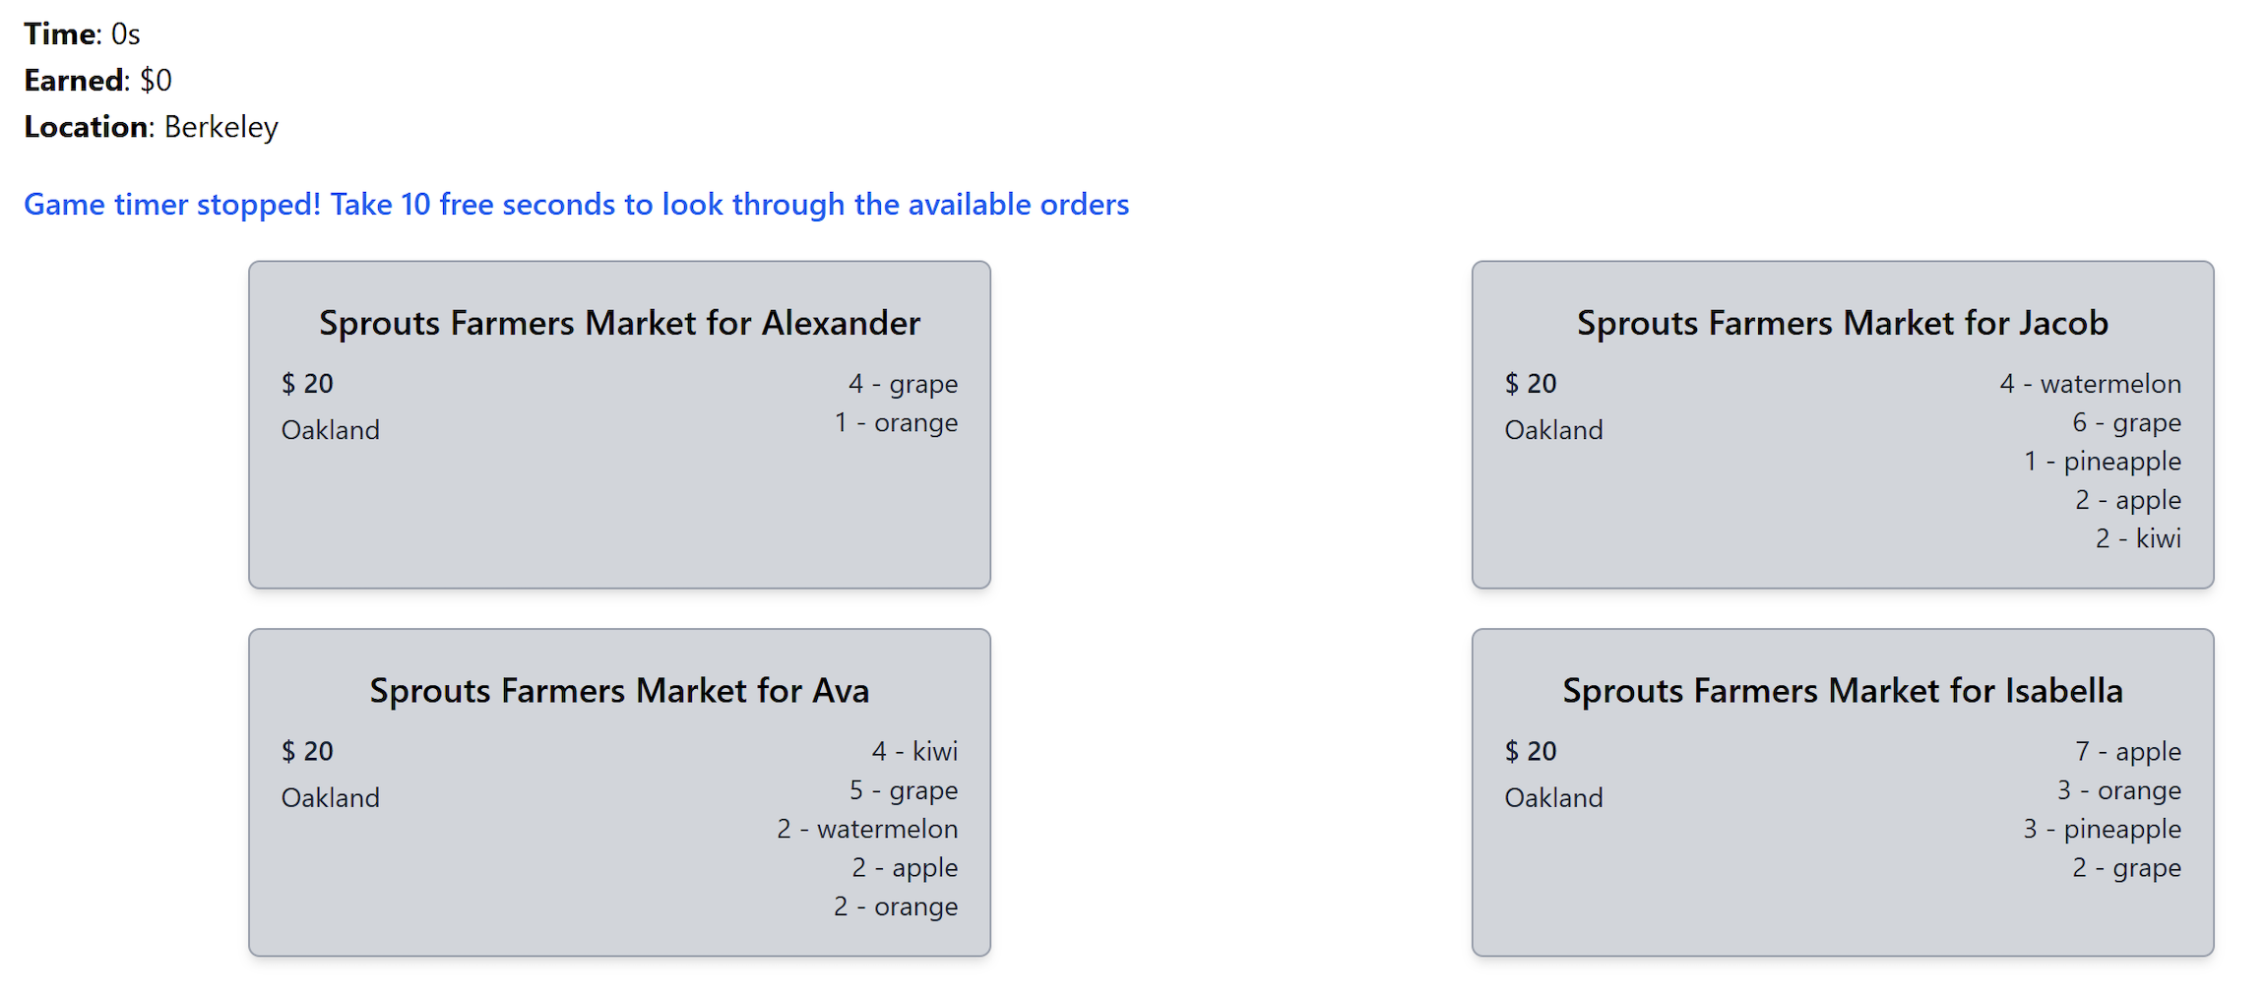
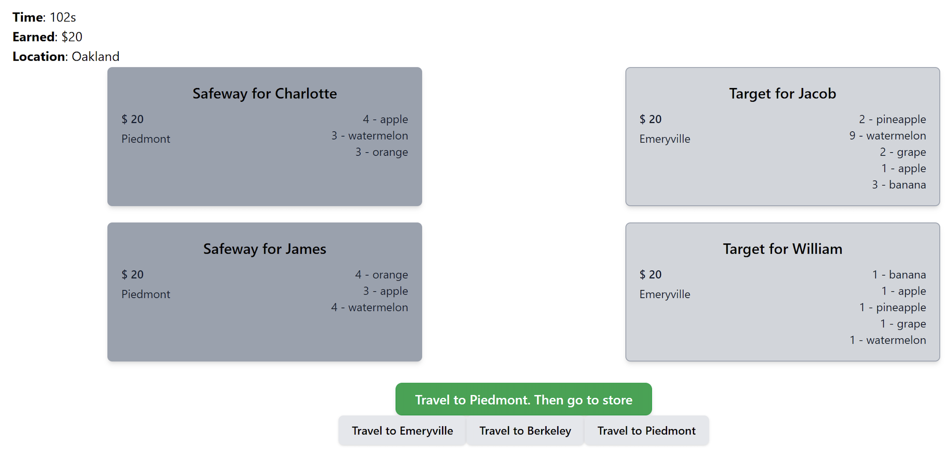
03
What’s Next?
Designing a Recommendation System + Experiments
Pilot findings:
Humans prioritize first available or seemingly-easier tasks, similar to Ibanez et al 2017‘s findings!
Notes:
"Building upon our empirical findings, we designed an algorithmic solution that actively supports gig worker learning. This solution moves beyond traditional engagement metrics like click-through rates, which often focus narrowly on short-term interactions."
"Instead, our recommendation system directly optimizes for long-term service quality, specifically targeting metrics such as on-time delivery and customer satisfaction."
"By dynamically assigning tasks, the algorithm not only helps gig workers continuously improve their skills but also strategically aligns worker activities with critical business objectives."
"Why is this important to businesses? Because aligning recommendations with strategic goals like worker retention and platform reputation directly translates into reduced turnover, lower training costs, and ultimately a stronger competitive edge in the gig economy.”
Given this objective in mind, let's now discuss how we plan to further refine our algorithm."

Slide 30
03
Algorithm
Designing Learning-Aware Job Recommendation System
Key Idea:
Move beyond traditional engagement metrics (e.g., click-through rate) to optimize directly for service quality metrics (on-time delivery, customer satisfaction).
Dynamically recommend jobs to maximize cumulative, long-term service quality.
Notes:
"Building upon our empirical findings, we designed an algorithmic solution that actively supports gig worker learning. This solution moves beyond traditional engagement metrics like click-through rates, which often focus narrowly on short-term interactions."
"Instead, our recommendation system directly optimizes for long-term service quality, specifically targeting metrics such as on-time delivery and customer satisfaction."
"By dynamically assigning tasks, the algorithm not only helps gig workers continuously improve their skills but also strategically aligns worker activities with critical business objectives."
"Why is this important to businesses? Because aligning recommendations with strategic goals like worker retention and platform reputation directly translates into reduced turnover, lower training costs, and ultimately a stronger competitive edge in the gig economy.”
Given this objective in mind, let's now discuss how we plan to further refine our algorithm."

Slide 31
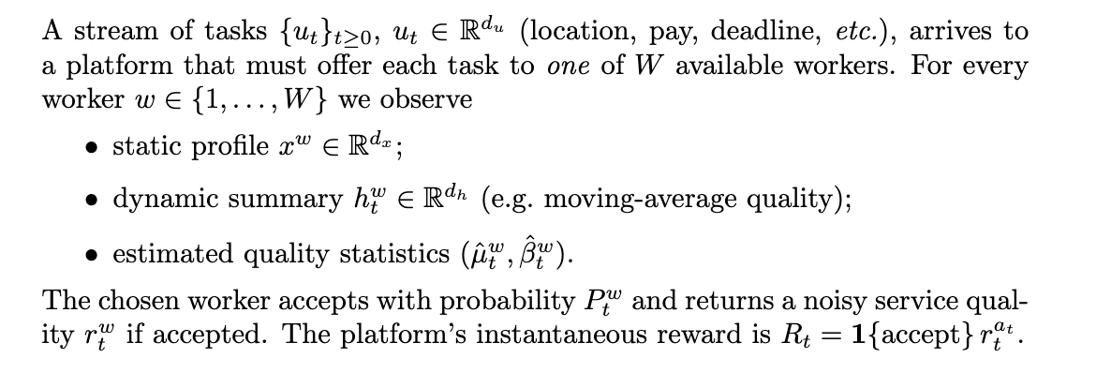
03
Algorithm
Problem Description
Notes:
On this slide, I’ll walk you through the core decision problem our platform faces at each time step.We assume tasks arrive one by one in a continuous stream. Each task, denoted utu_tut​, carries its own attributes—location, pay, deadline, and so on. We have W workers to choose from. For every worker w, the platform knows: A static profile (think demographics, skill set). A dynamic summary that captures recent performance—say a moving average of their ratings. Estimated quality statistics which we’ll use to gauge expected service quality and uncertainty.”
Once we offer the task to a selected worker, they accept with a probability​. If they accept, they deliver a noisy quality signal​. The platform’s reward at time t is simply the product of acceptance and quality
In practice, this captures both whether the task gets done and how well it’s done. With this setup, our goal is to maximize cumulative reward. In the next slide, I’ll introduce the algorithmic framework we use to strike that balance.”

Slide 32
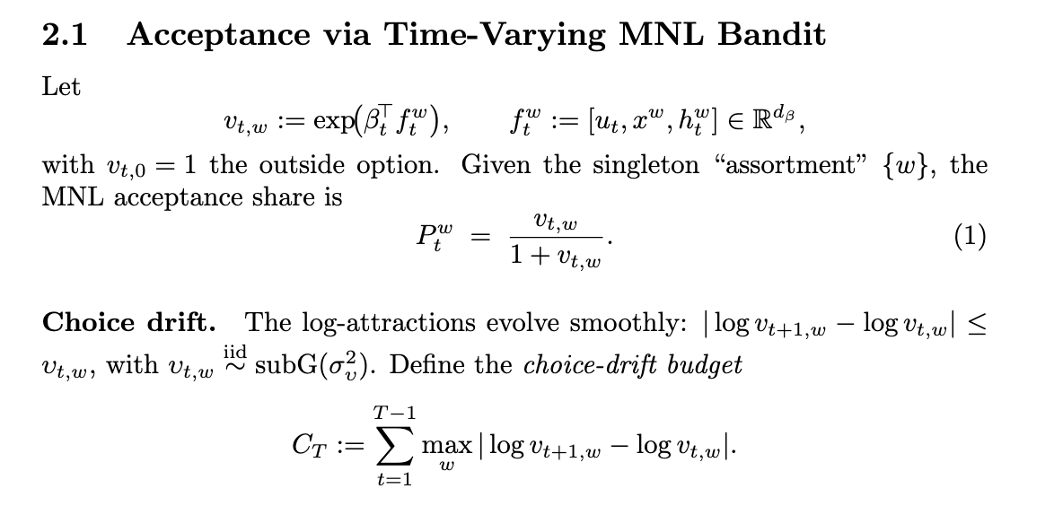
03
Algorithm
Worker Behavior Model
Notes:
We model each worker’s willingness to accept as a multinomial logit that changes over time.
Preferences aren’t fixed, they drift smoothly, with sub-Gaussian fluctuations (as suggested by our empirical studies
We capture total variation in a drift budget
This model and budget let us track changing worker tastes and guide our explore–exploit strategy.

Slide 33
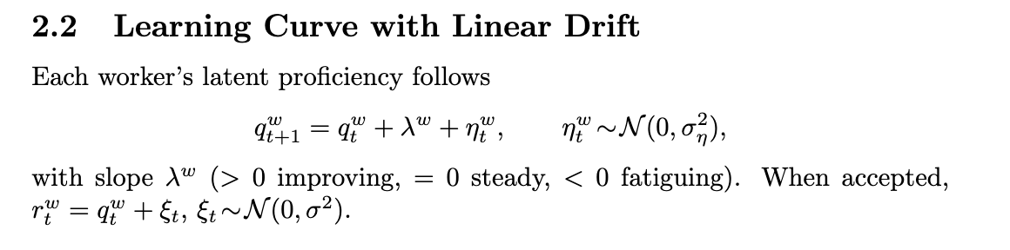
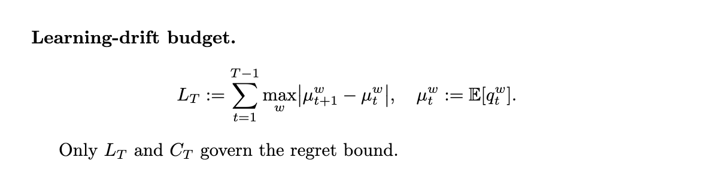
03
Algorithm
Worker Behavior Model
Notes:
Each worker has an underlying skill level that shifts gradually over time. On every task, their “true” proficiency increases or decreases by a fixed personal rate (their learning slope) plus a small random fluctuation. If the slope is positive, they steadily improve; if it’s zero, they stay about the same; if it’s negative, they fatigue or decline. When a worker actually completes an accepted task, we don’t see their true proficiency exactly. Instead, we observe a noisy version of it, think of it as the true skill level plus some measurement error. Over the whole sequence of tasks, we track how much each worker’s expected skill can change. We sum up the largest expected jumps in proficiency between consecutive time steps across all workers. This total “drift budget” captures the overall non-stationarity of workers’ learning curves. The algorithm’s performance guarantee (its regret bound) will finally depend on two things: the total amount of choice-drift (how much acceptance probabilities can shift) and this learning-drift budget (how much skill levels can shift).

Slide 34
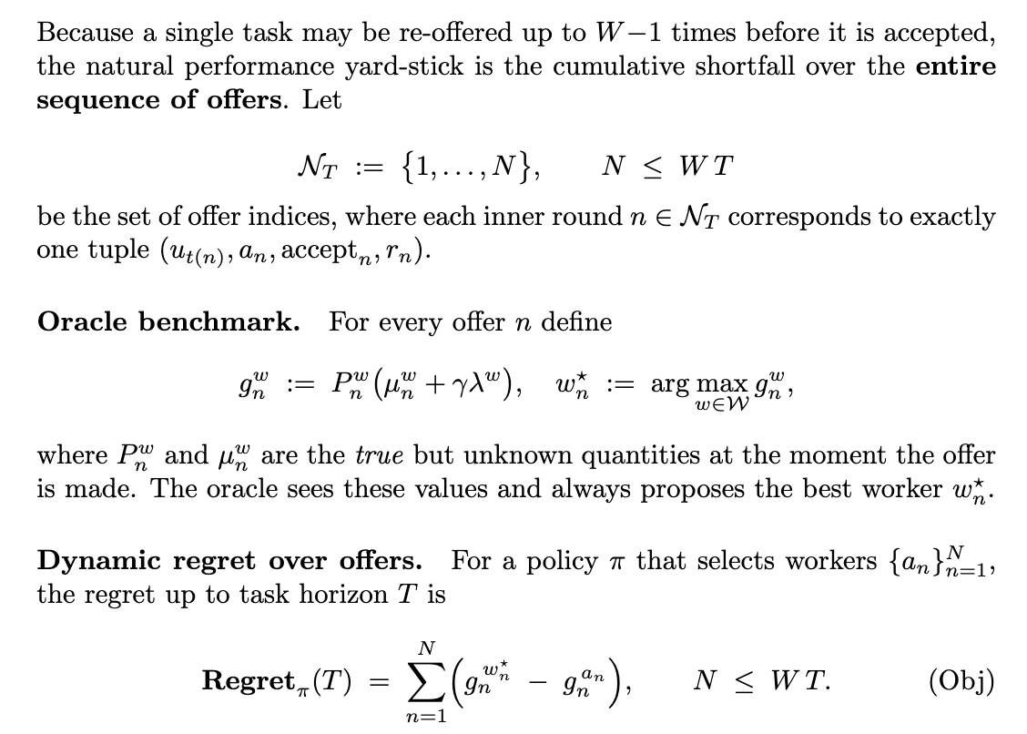
03
Algorithm
Regret Definition
Notes:
This slide defines how we measure the algorithm’s regret, or how much reward we lose by not knowing the true best choice in advance.
We imagine an all-knowing “oracle” who, at each of these offer rounds, sees the real acceptance chance and true expected quality (including any learning-curve benefit) for every worker and always picks the one with the highest actual payoff.
Our algorithm, by contrast, only has estimates and picks a worker that may not be optimal. The regret is then the sum, over all offer attempts, of the gap between the oracle’s payoff and our algorithm’s payoff. In short, dynamic regret here quantifies the cumulative lost reward across every offer, up until all tasks are finally accepted.

Slide 35
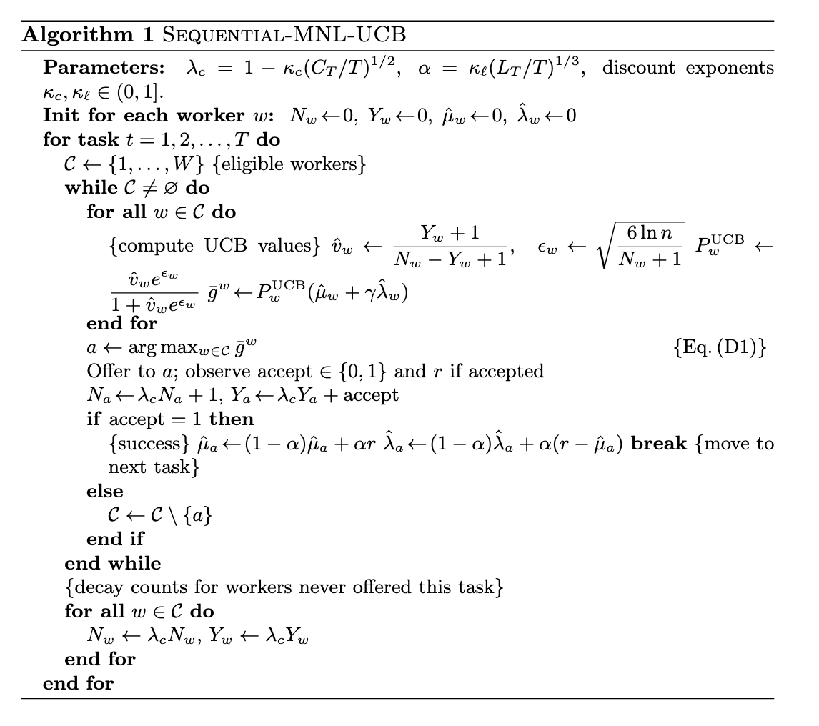
03
Algorithm
Algorithm Procedure
Notes:
This algorithm manages task assignment in two nested loops, over tasks and, for each task, over candidate workers, using an upper-confidence strategy that balances exploration of uncertain workers against exploitation of those known to perform well.
Setup and Parameters
We begin by choosing how much to discount past data (to handle non-stationarity) and how aggressively to explore based on our drift budgets.
For every worker, we track two running counts: the total number of times they’ve been offered a task, and the number of times they’ve accepted and completed it. We also maintain online estimates of their average service quality and their learning slope.
Per-Task Loop
When a new task arrives, we initialize the “eligible” set to include all workers.
We then repeatedly do the following until someone accepts or we exhaust all candidates: a. Compute UCB Score For each worker still eligible, we form an optimistic payoff estimate by combining:
Their estimated acceptance probability,
Their estimated average quality,
A bonus proportional to our uncertainty about both acceptance and quality,
And an adjustment for their learning slope.
b. Select and Offer We pick the worker with the highest optimistic score and offer them the task. c. Observe and Update
If they accept, we record that success and observe a noisy service quality.
We then update that worker’s counts and smoothly update both their average quality estimate and their learning slope.
Finally, we break out of the inner loop and move on to the next task.
d. Rejection Handling
If they reject, we remove that worker from the eligible set and repeat the inner loop with the remaining candidates.
Discounting Unused Data
Once a task is completed, any workers who were never offered that particular task still have their historical counts decayed. This ensures old information gradually loses weight, letting the algorithm adapt to shifts in worker behavior or proficiency over time.
By iterating this process, the algorithm continually refines its estimates and balances exploring under-utilized workers against exploiting reliably high performers, all while accounting for changing acceptance rates and evolving skill levels.

Slide 36
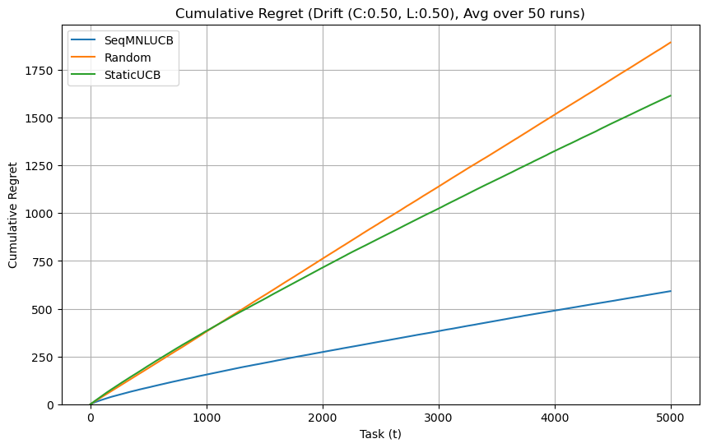
03
Algorithm
Regret Simulation
Notes:
Overview of Plots Here we compare three policies—our Sequential MNL-UCB, a static UCB, and random assignment, over 5,000 tasks, averaging across 50 runs.
Left Panel: Low Drift (C=0.05, L=0.05) With only small changes in acceptance probabilities and quality (low drift), the static UCB already outperforms random, but its regret still grows nearly linearly. Our SeqMNL-UCB, in contrast, exhibits the familiar sublinear, square-root-style growth—regret around 550 by task 5,000, showing effective adaptation to slight nonstationarity.
Right Panel: High Drift (C=0.50, L=0.50) When drift is ten times larger, both random and static UCB suffer much higher regret, approaching 1,600-1,900 by the end. SeqMNL-UCB’s regret also increases, but remains substantially lower (around 600), demonstrating robustness even under rapidly changing worker behavior and learning.
These simulation suggests regret scales with the total drift budgets C and L, and our algorithm consistently outperforms baselines by balancing exploration, exploitation, and discounting over time.

Slide 37
03
Algorithm
Next steps
Run more simulation with historical data simulation (train a transformer-based model)
Consider assortment recommendation, consider recommending to multiple workers at the same time

Slide 38

04
Summary
Take-aways
How gig workers choose gig tasks and learn to improve performance over time?
Context: On-demand delivery workers
Empirical findings:
Workers learn to perform better and make better decisions; workers who exploit more / rely more on platform recommendations initially improve performance the most
Overtime workers behaviors change a lot; and they become independent on the current recommendation algorithm
Algorithm:
Model job recommendation as learning curve and choice model aware contextual bandits
Simulation shows it achieves sublinear regret in a drifting environment
Thank you!
Shunan Jiang (shunan_jiang@@berkeley.edu / shunanjiang.github.io) & Park Sinchaisri (parksinchaisri@berkeley.edu / parksinchaisri.github.io)

Slide 39
02
Empirical Analysis
Learning to Choose Better Tasks
Categorize workers based on items picked per hour and fit choice set data into a MNL model:
X includes (would make this later)
'ORDER_TYPE_ID', 'BUNDLED', 'MAX_CONTRIBUTIONS_CAT_PCT', 'MILES_DISTANCE_STORE_CUST',
'REQUESTED_ITEMS', 'PREV_100_TOTAL_DOLLARS', 'DOLLARS_BONUS', 'DOLLARS_PAY',
'LOCAL_DELIVERY_WINDOW_HOUR', 'EXPLORE_WITH_OPTIONS', 'LIST', 'PCT_DAILY_NONFOOD_ITEMS',
'PCT_EXPANDED_FOOD_ITEMS', 'PCT_GENERAL_MERCH_ITEMS'

Slide 40
02
Empirical Analysis
Learning to Choose Better Tasks
Categorize workers based on items picked per hour and fit choice set data into a MNL model:
Start\End Bundled | Low | High
Low-First 100 | -0.3453 | -0.4608
Low-Sec 100 | -0.0835 | -0.2564
Start\End List | Low | High
Low-First 100 | 1.0781 | 0.9728
Low-Sec 100 | 0.0521 | -0.6155
Improved workers choose less platform bundled data and choose less with recommendations

Slide 41
02
Empirical Analysis
Learning to Choose Better Tasks
Categorize workers based on items picked per hour and fit choice set data into a MNL model:
Start\End Bundled | Low | High
Low-First 100 | -0.3453 | -0.4608
Low-Sec 100 | -0.0835 | -0.2564
Start\End List | Low | High
Low-First 100 | 1.0781 | 0.9728
Low-Sec 100 | 0.0521 | -0.6155
Improved workers choose less platform bundled data and choose less with recommendations
Why this is the reason
Notes:
Other coefficient

Slide 42
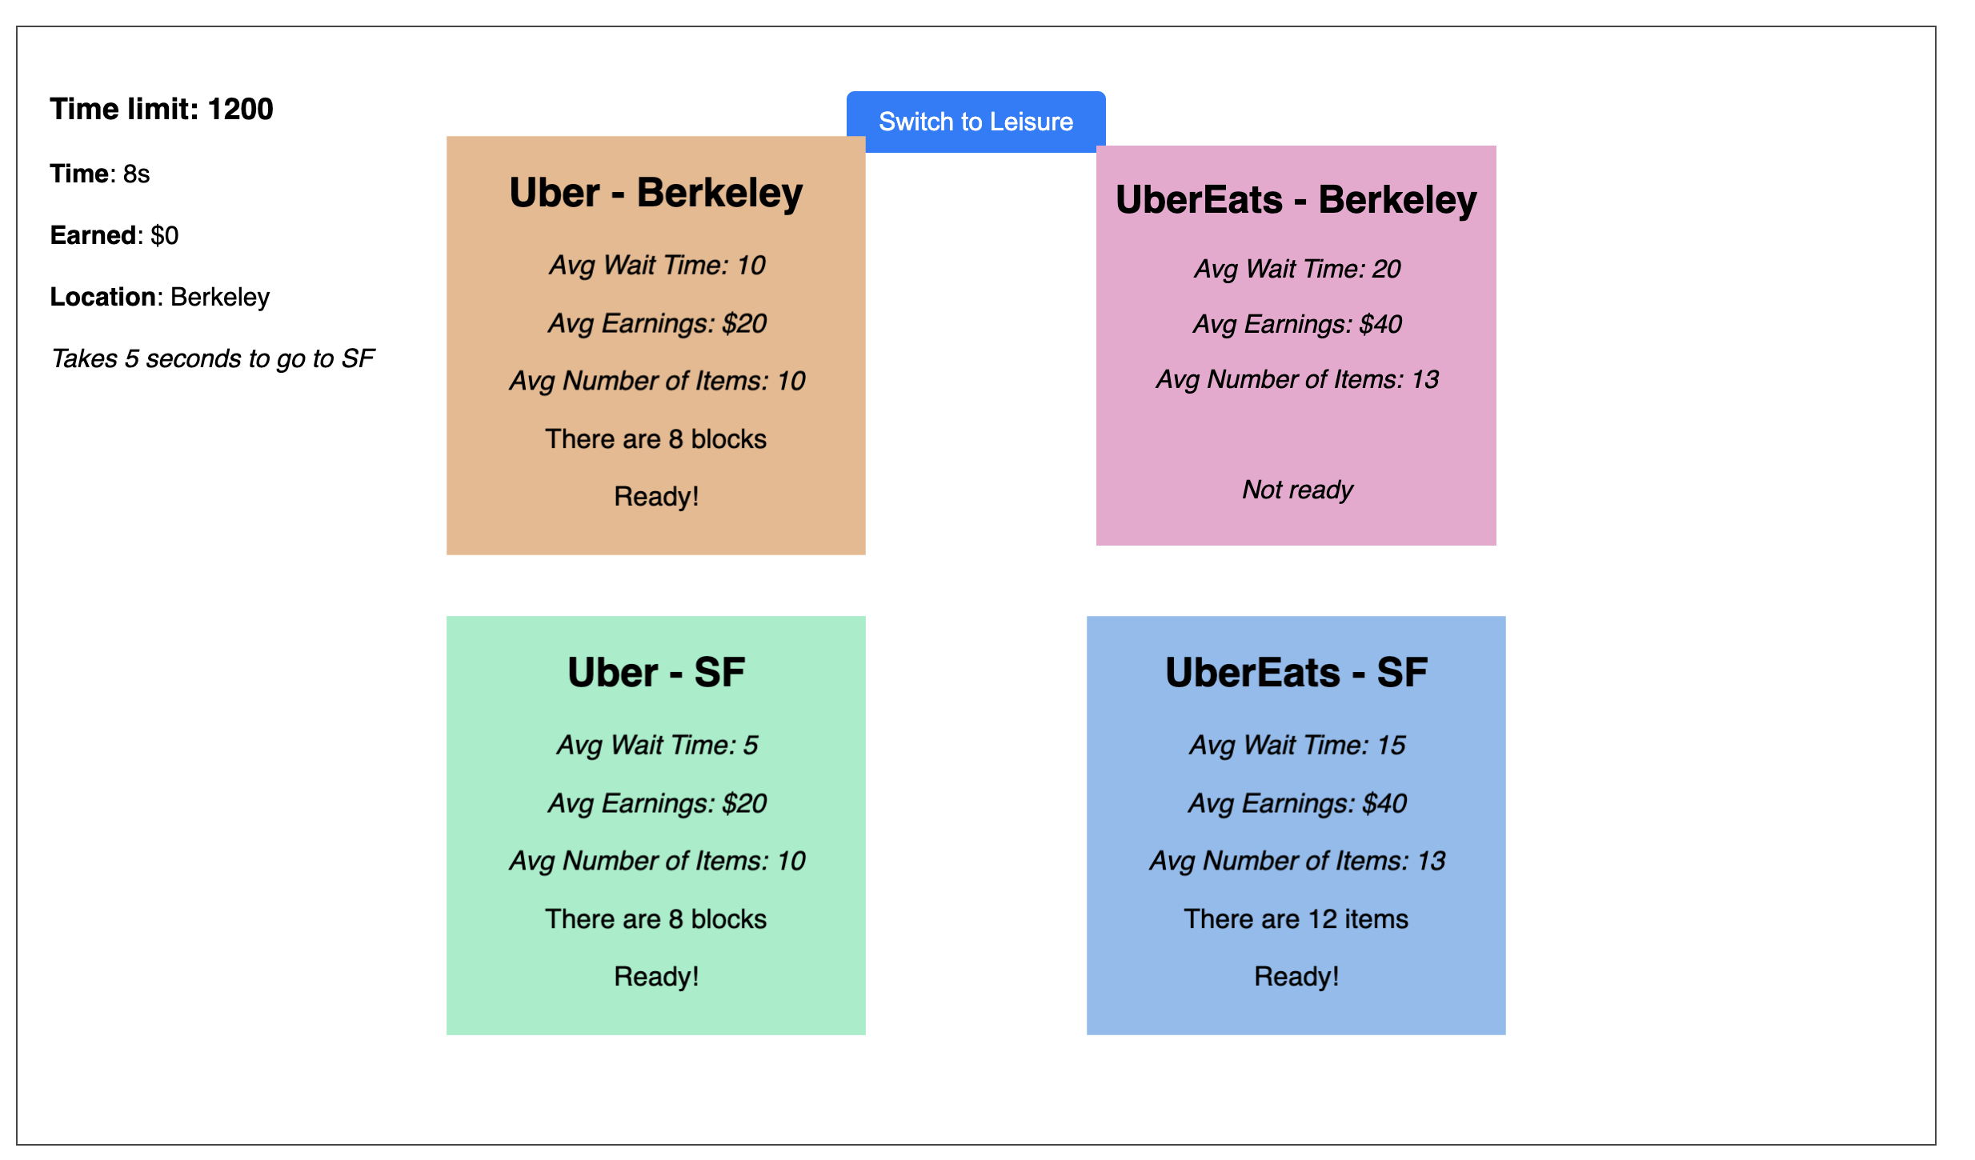
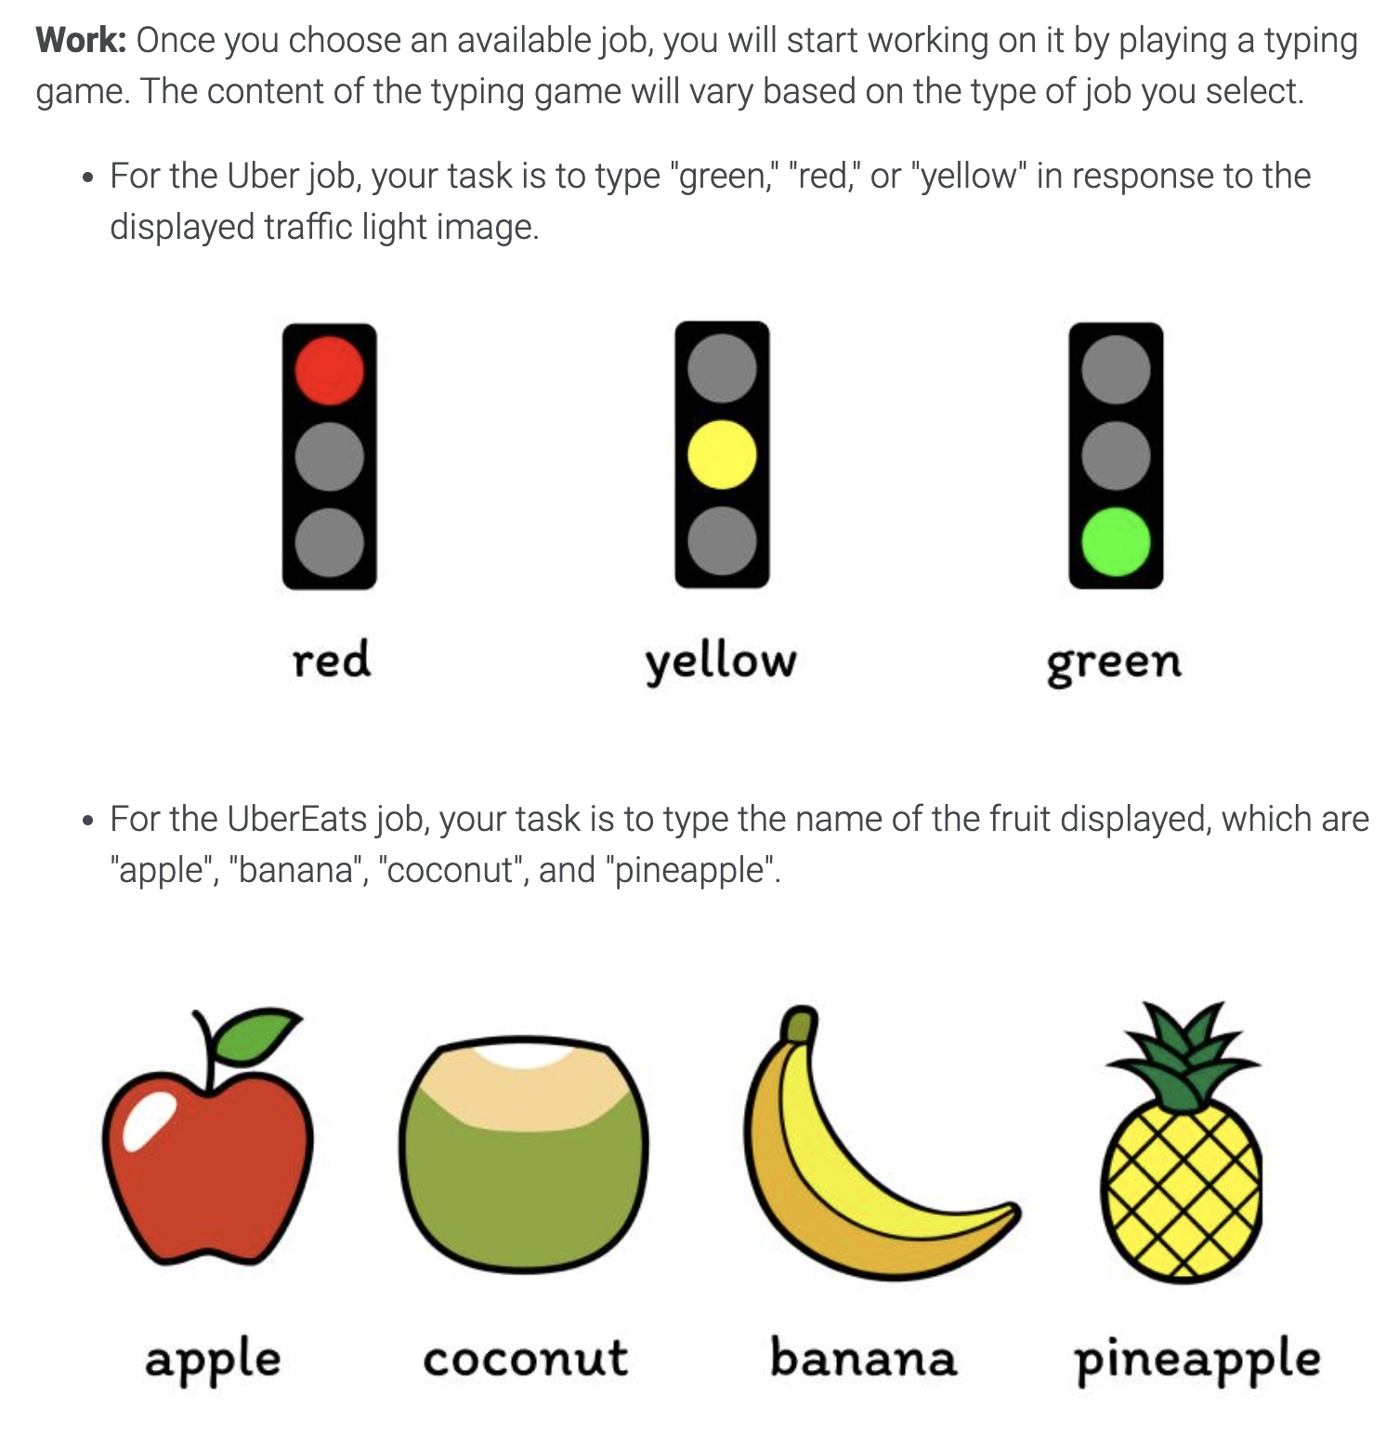
03
Behavioral Experiment Design
Design & Pilot Results
Uber tasks
UberEats tasks
Workers choose first-arriving tasks 60% to 80% of the times
They are more likely to choose seemingly short/easy tasks

Slide 43
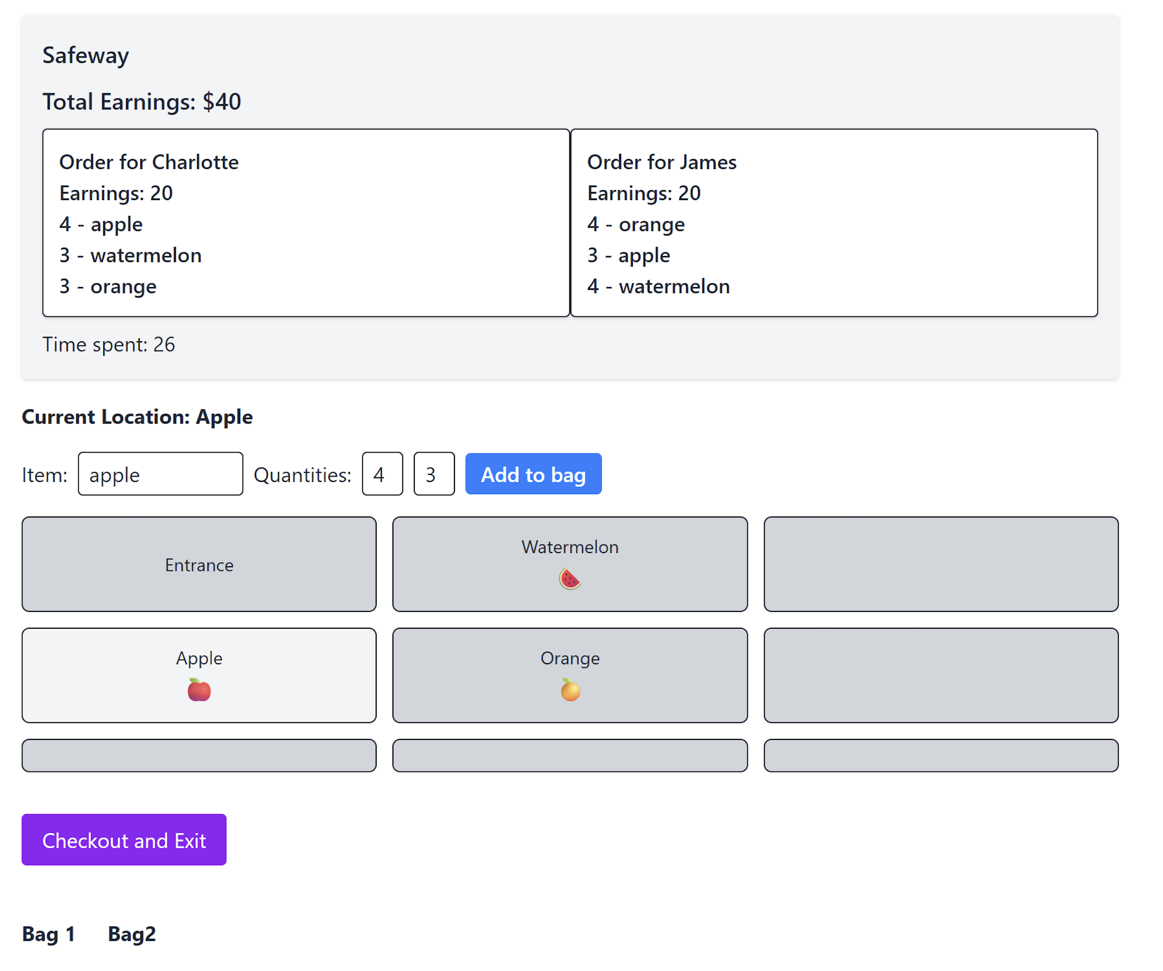
03
Behavioral Experiment Design
New experiment in the making

Slide 44
04
Summary
How gig workers choose jobs and learn to improve performance over time?
Context: On-demand delivery workers
Empirical findings:
Bundling is strategic, but workers tend to over-bundle, hurting performance
Potential impact of platform’s bundled order recommendations
Workers learn to perform better and make better decisions; workers who explore/exploit just the right amount improve performance the most
Experimental findings: Humans prioritize first available or seemingly-easier tasks
Thank you!
Shunan Jiang (shunan_jiang@@berkeley.edu / shunanjiang.github.io) & Park Sinchaisri (parksinchaisri@berkeley.edu / parksinchaisri.github.io)

